Slide 1
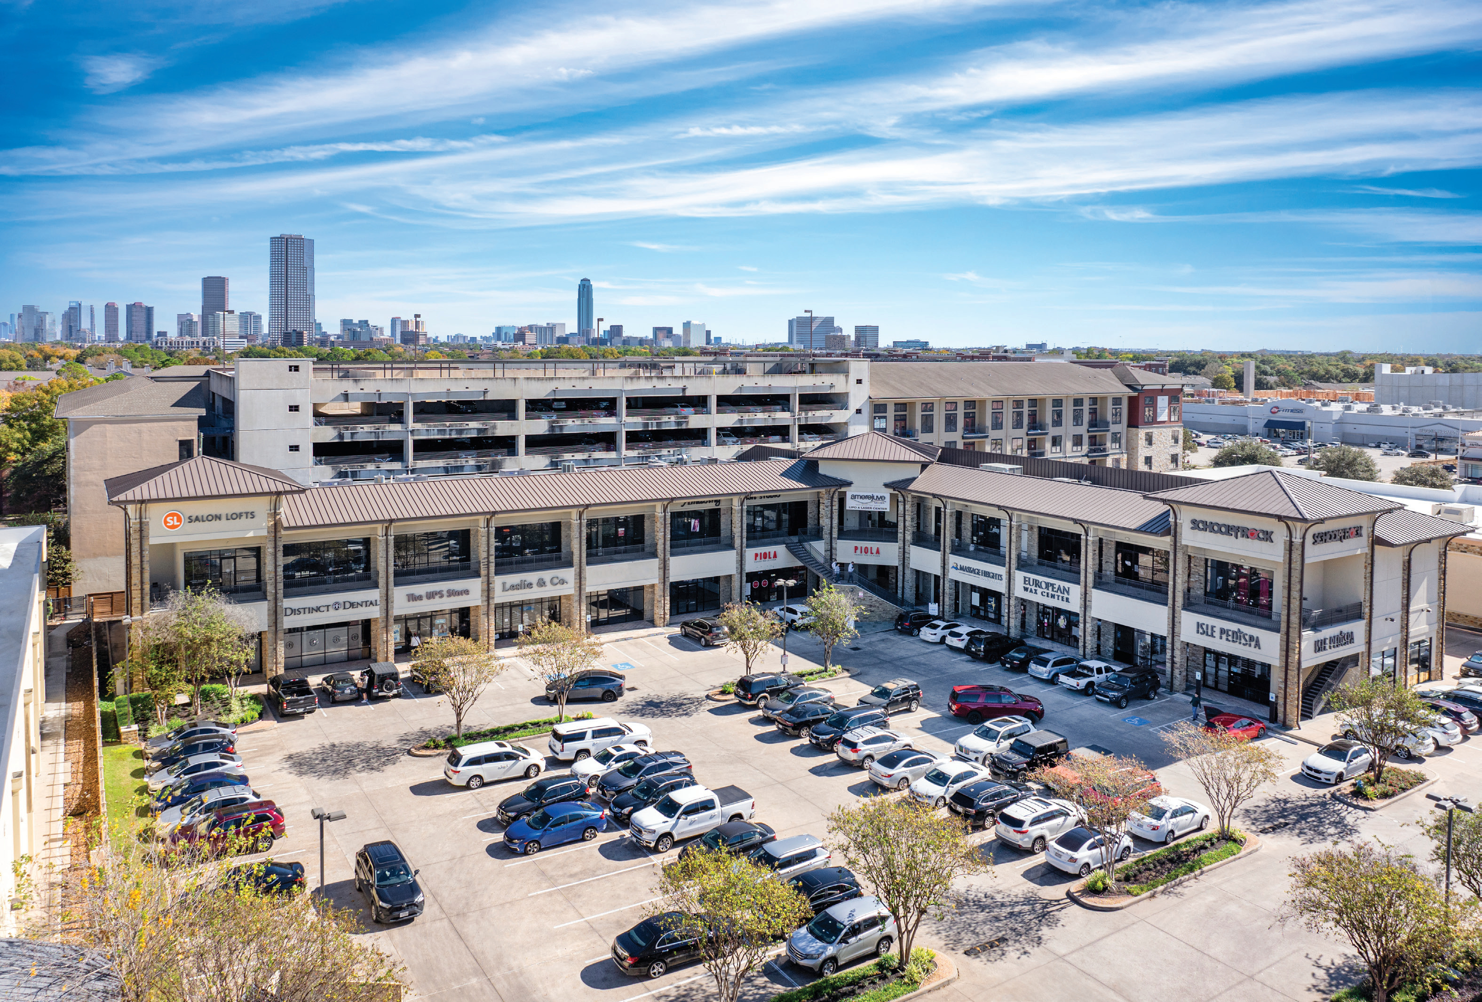
JAL-JCP REAL ESTATE PARTNERS
THE SHOPPES AT
SAN FELIPE
OFF-MARKET INVESTMENT OFFERING
61,196
4.54
95.2%
SF RETAIL
ACRES
OCCUPIED
NEC SAN FELIPE & S. VOSS | HOUSTON, TEXAS 77057
CONFIDENTIAL
MAY 2026

Slide 2
00
DISCLOSURE
Notice to Investors
The information contained herein is provided to you for information purposes only, is unaudited, and is not, and may not be relied on in any manner as, legal, tax or investment advice. Prospective investors should consult with their own legal, tax and financial advisers as to the consequences of an investment. These materials have been prepared as a means to provide information to investors interested in certain investments managed by JAL-JCP Real Estate Partners, LLC (“JAL-JCP”) which will be advised by JCP Investment Management, LLC (“JCPIM”).
Investment will involve significant risks, including risk of loss of the entire investment. Before deciding to invest, prospective investors should pay particular attention to the risk factors associated including but not limited to: (i) an investment in real estate assets may result in a loss of investment; (ii) dependence on key personnel may result in additional operational risk; and (iii) the investment will be managed exclusively by JAL-JCP and (iv) JCPIM and/or an affiliated entity will be advising JAL-JCP. Investors should have the financial ability and willingness to accept the risk characteristics of the discussed investment.
The information contained herein must be kept strictly confidential and may not be reproduced or redistributed in any format without JAL-JCP’s express written approval. Certain information contained herein has been obtained from published and non-published sources and has not been independently verified by JAL-JCP. Except where otherwise indicated, the information provided herein is based on matters as they exist as of the date of preparation and not as of any future date and will not be updated to reflect information that subsequently becomes available.
Certain information contained herein constitutes “forward-looking statements,” which can be identified by the use of forward-looking terminology such as “may,” “will,” “seek,” “should,” “expect,” “anticipate,” “project,” “estimate,” “intend,” “continue” or “believe” or the negatives thereof. Due to various risks and uncertainties, actual events or results may differ materially from those reflected or contemplated in such forward-looking statements.
Unless otherwise stated, all projected rates of return are presented on a “gross” basis (i.e., they do not reflect the “promote,” taxes and other expenses to be borne by investors, which in the aggregate could be substantial). Past performance can be no assurance of future results.
This document is for informational purposes only. It does not constitute an offer to sell or the solicitation of an offer to buy any interest in a security. Investments should only be made by investors who fully understand these risks and can withstand a loss of their entire investment.
JAL-JCP REAL ESTATE PARTNERS
SHOPPES AT SAN FELIPE | MAY 2026
i

Slide 3
01
DEAL SNAPSHOT
Deal Snapshot
Off-Market Acquisition / Sponsor-Discretion Exit / Land-Sale Modeled
18.27%
3.70x
15.73%
3.11x
8.22%
PROJECT IRR
PROJECT MULTIPLE
LP IRR (NET)
LP EQUITY MULTIPLE
AVG CASH-ON-CASH
INVESTMENT SUMMARY
MODELED EXIT — LAND SALE
Purchase Price
$31,750,000
Land Sale (197,762 SF × $300/SF)
$59,328,600
Total Basis
$32,500,000
Less: Loan Payoff
($25,374,931)
Going-In Cap Rate
5.94%
Less: Disposition Costs (2.0%)
($1,186,572)
Year 1 NOI (MTM)
$1,982,029
Net Proceeds to Equity
$32,767,097
LP Equity Required
$14,000,000
+ Op CF + Refi + Y10 Escrow
$18,993,094
Senior Debt (SouthState · 60% LTV)
$19,500,000
Total Distributions
$51,760,191
Interest Rate
6.06%
LP Total Distributions
$43,508,153
I/O → Amortization
2-yr IO + 3-yr P&I (30-yr Am)
Avg Cash-on-Cash
8.22%
JAL-JCP REAL ESTATE PARTNERS
SHOPPES AT SAN FELIPE | MAY 2026
1

Slide 4
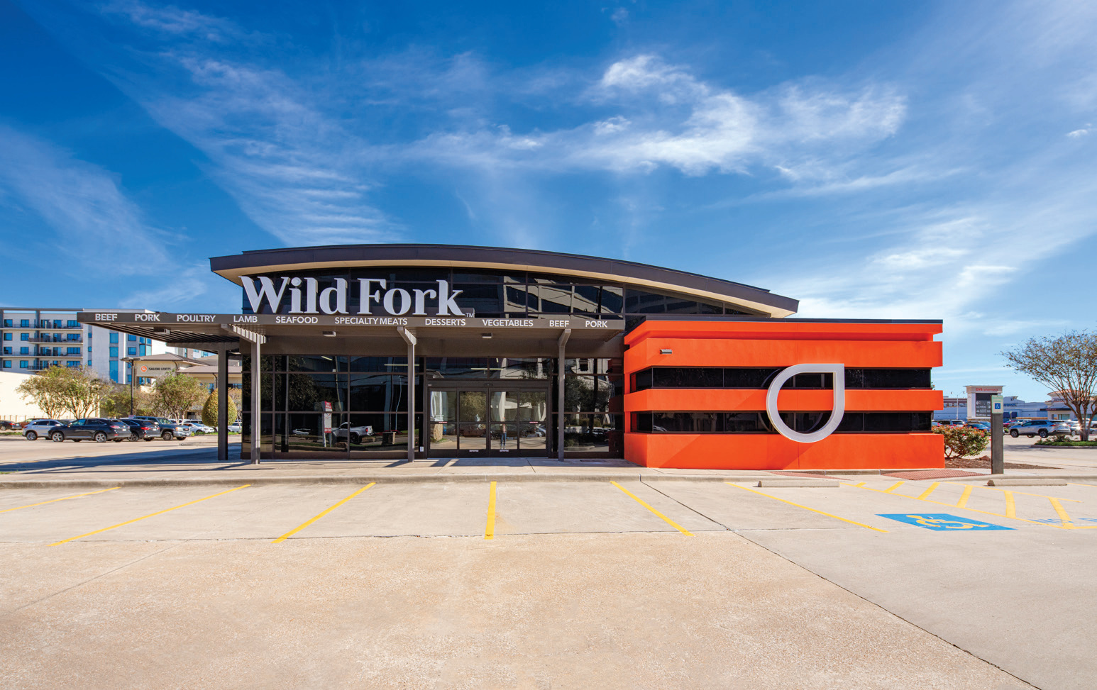
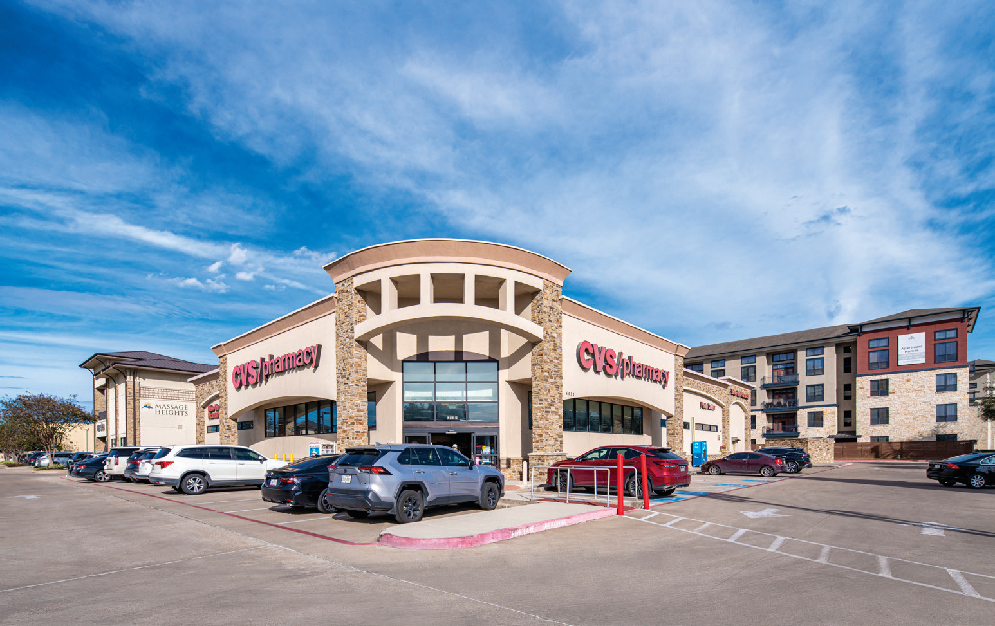
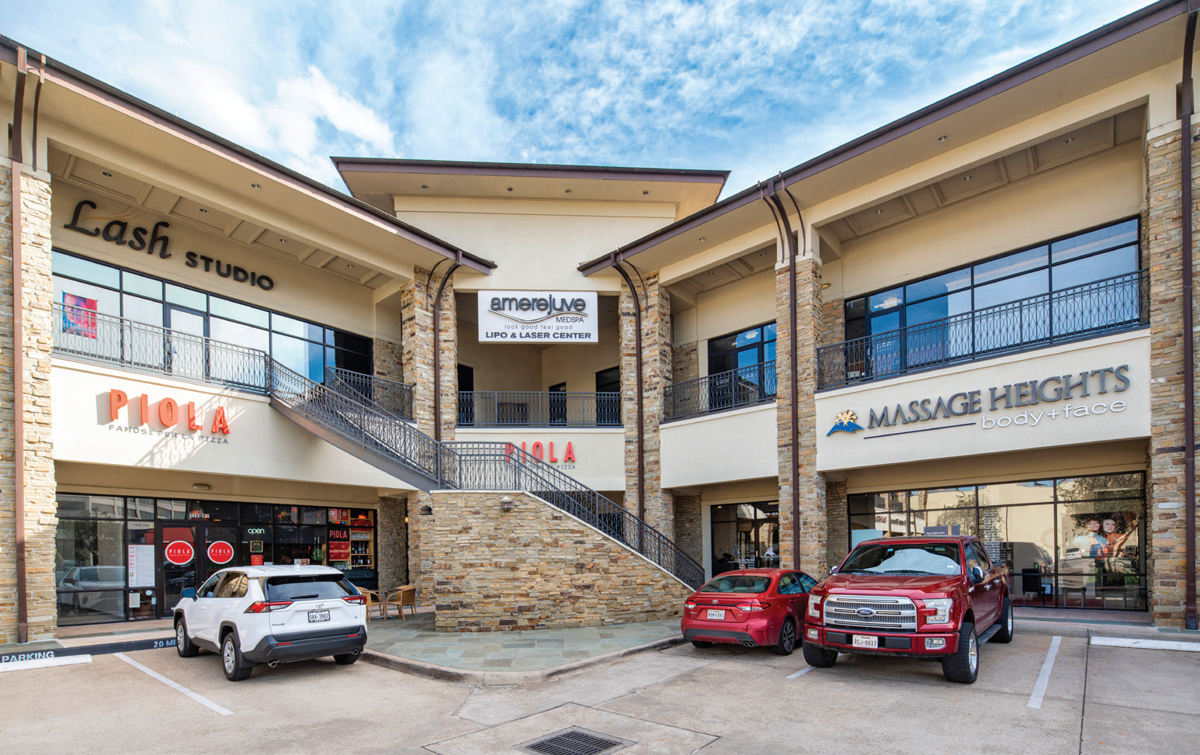
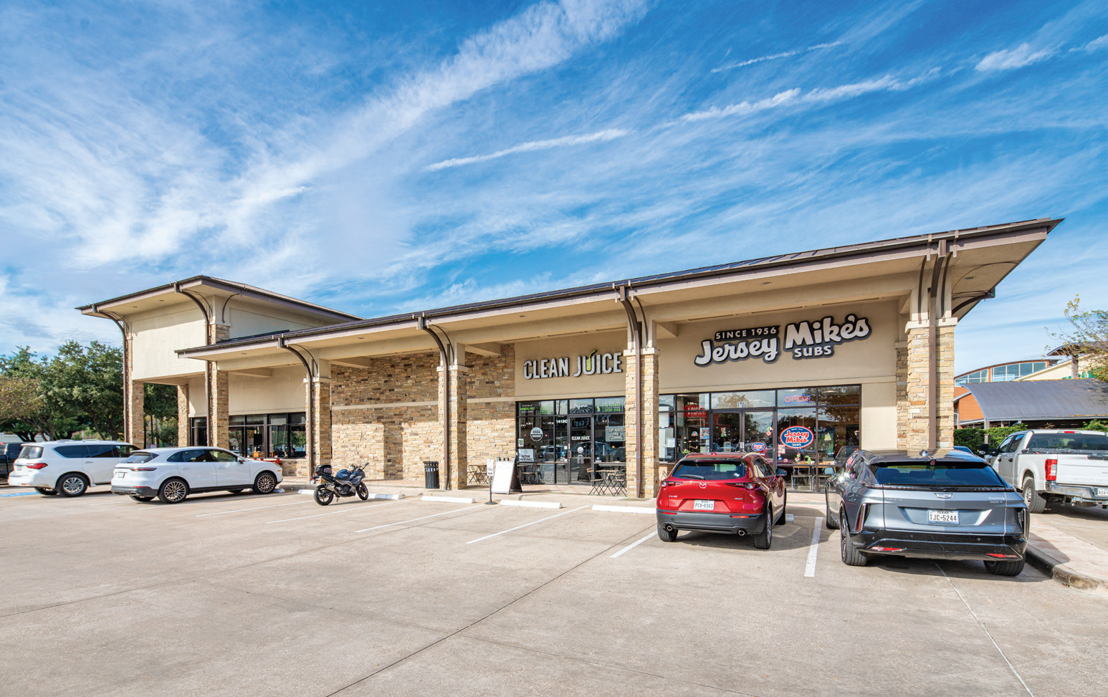
02
THE PROPERTY
Property Overview
Wild Fork Foods
CVS Pharmacy
East Wing
North Wing
JAL-JCP REAL ESTATE PARTNERS
SHOPPES AT SAN FELIPE | MAY 2026
2

Slide 5
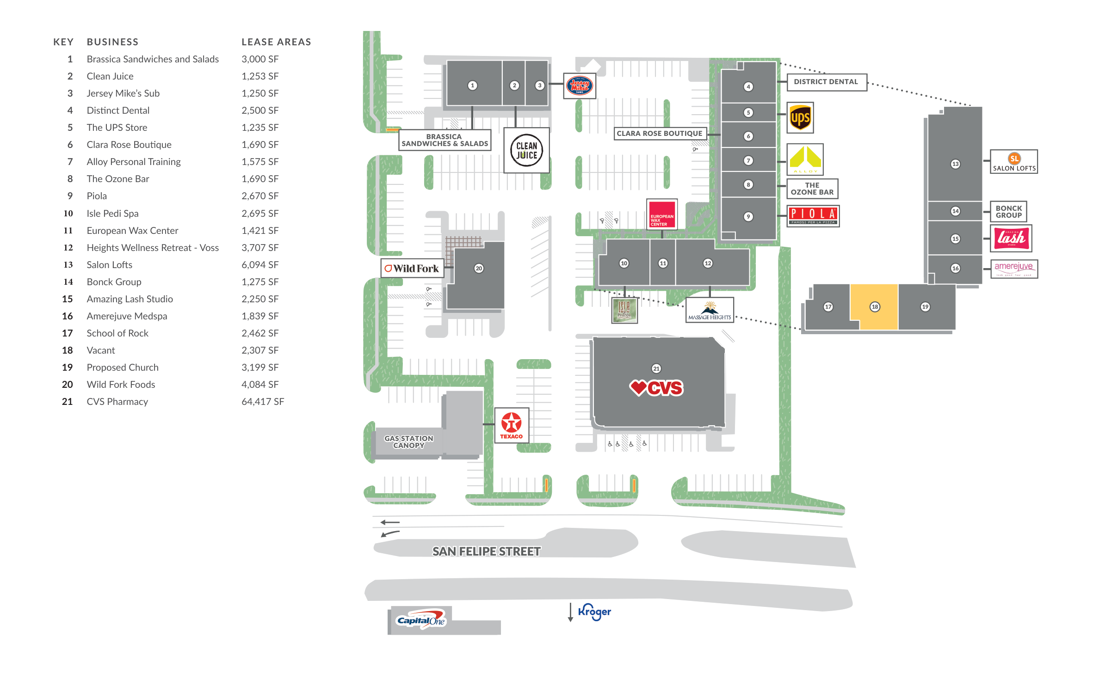
02
THE PROPERTY
Site Plan
61,196 SF retail center on 4.54 acres at the NEC of San Felipe & S. Voss.
JAL-JCP REAL ESTATE PARTNERS
SHOPPES AT SAN FELIPE | MAY 2026
3

Slide 6
03
FINANCIALS
Financial Overview
YEAR 1 OPERATING STATEMENT
CASH FLOW SUMMARY (UNDERWRITTEN HOLD)
Rental Revenue
 | Yr 1 | Yr 2 | Yr 3 | Yr 4 | Yr 5 | Yr 6 | Yr 7 | Yr 8 | Yr 9 | Yr 10
NOI | $1,982K | $2,071K | $2,181K | $2,305K | $2,440K | $2,485K | $2,648K | $2,750K | $2,917K | $2,994K
Debt Svc | $1,182K | $1,182K | $1,412K | $1,412K | $1,412K | $1,331K | $1,331K | $1,714K | $1,714K | $1,714K
+ T-bill Int | $43K | $34K | $33K | $34K | $32K | $32K | $31K | $29K | $23K | $23K
Op. CF | $843K | $923K | $802K | $927K | $1,059K | $1,187K | $1,349K | $1,066K | $1,226K | $1,303K
CoC | 6.48% | 7.10% | 6.17% | 7.13% | 8.15% | 9.13% | 10.38% | 8.20% | 9.43% | 10.02%
Potential Base Rent
2,067,017
Absorption & Turnover Vacancy
(32,298)
Scheduled Base Rent
2,034,719
Total Rental Revenue
2,034,719
Other Tenant Revenue
Total Expense Recoveries
604,360
Total Other Tenant Revenue
604,360
Total Op CF (10-yr): $10.69M / Avg Cash-on-Cash: 8.22% / Yr 5 Refi Cash-Out: $7.74M
Total Tenant Revenue
2,639,079
Other Revenue
Signage Income
3,120
MODELED LAND-SALE EXIT
Total Other Revenue
3,120
Potential Gross Revenue
2,642,199
Land Sale (197,762 SF × $300/SF)
$59,328,600
Effective Gross Revenue
2,642,199
Operating Expenses
Less: Loan Payoff
($25,374,931)
CAM
161,235
Less: Disposition Costs (2.0%)
($1,186,572)
CAM – Utilities
65,794
TAX
403,580
Net Sale Proceeds
$32,767,097
INS
36,675
ADMIN
8,370
LP Total Distributions (incl ops)
$43,508,153
Management Fee (3%)
79,266
Total Operating Expenses
754,919
Net Operating Income
1,887,280
JAL-JCP REAL ESTATE PARTNERS
SHOPPES AT SAN FELIPE | MAY 2026
4

Slide 7
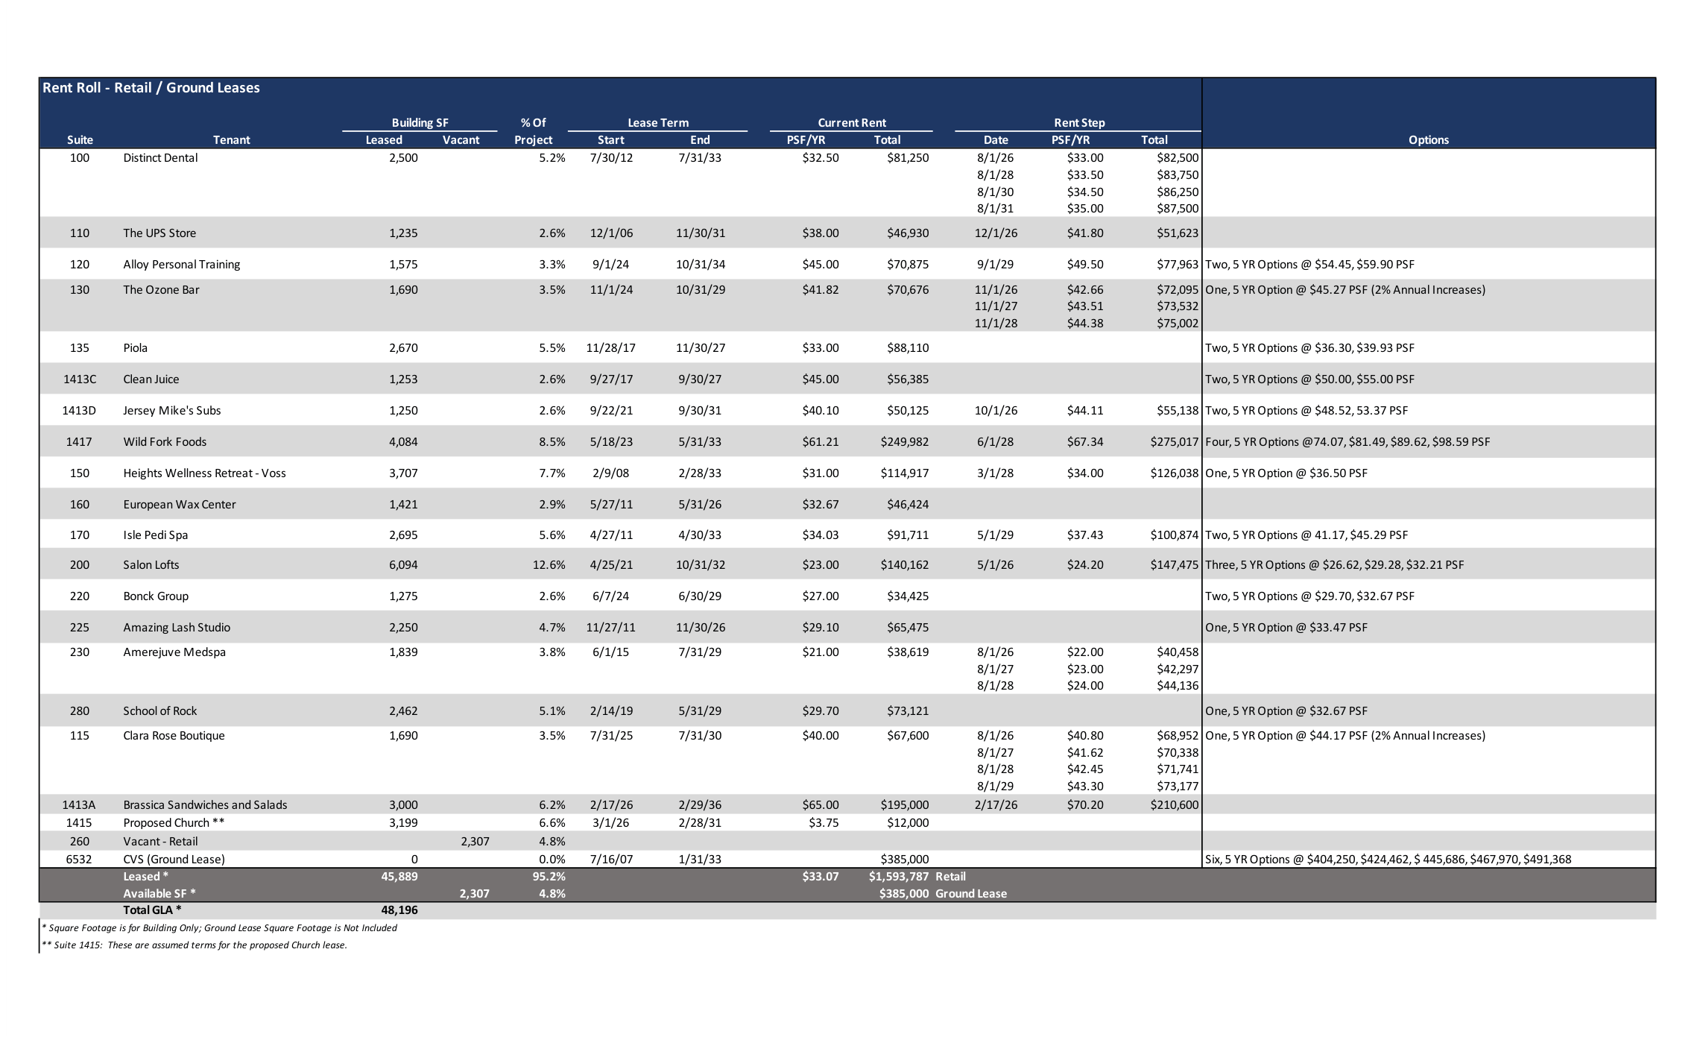
03
FINANCIALS
Rent Roll
21 tenants / 95.2% occupied / WALT 5.77 yrs / $1.98M Yr 1 in-place rent
SUITE | TENANT | SF | % GLA | LEASE END | PSF | ANNUAL RENT | NOTES / OPTIONS
100 | Distinct Dental | 2,500 | 5.2% | 7/31/33 | $32.50 | $81,250 | Steps to $35 PSF by 2031
110 | The UPS Store | 1,235 | 2.6% | 11/30/31 | $38.00 | $46,930 | Steps to $41.80 PSF (12/26)
115 | Clara Rose Boutique | 1,690 | 4.3% | 7/31/30 | $40.00 | $67,600 | 2% annual · One 5-yr opt @ $44.17
120 | Alloy Personal Training | 1,575 | 3.3% | 10/31/34 | $45.00 | $70,875 | Two 5-yr opts @ $54.45, $59.90
130 | The Ozone Bar | 1,690 | 4.3% | 10/31/29 | $41.82 | $70,676 | 2% annual · One 5-yr opt @ $45.27
135 | Piola | 2,670 | 5.5% | 11/30/27 | $33.00 | $88,110 | Two 5-yr opts @ $36.30, $39.93
150 | Heights Wellness Retreat | 3,707 | 7.7% | 2/28/33 | $31.00 | $114,917 | One 5-yr opt @ $36.50
160 | European Wax Center | 1,421 | 2.9% | 5/31/26 | $32.67 | $46,424 | Expiring · 2026 mark-to-market
170 | Isle Pedi Spa | 2,695 | 5.6% | 4/30/33 | $34.03 | $91,711 | Two 5-yr opts @ $41.17, $45.29
200 | Salon Lofts | 6,094 | 13.1% | 10/31/32 | $23.00 | $140,162 | Three 5-yr opts to $32.21
220 | Bonck Group | 1,275 | 2.6% | 6/30/29 | $27.00 | $34,425 | Two 5-yr opts @ $29.70, $32.67
225 | Amazing Lash Studio | 2,250 | 4.7% | 11/30/26 | $29.10 | $65,475 | Expiring · 2026 mark-to-market
230 | Amerejuve Medspa | 1,839 | 3.8% | 7/31/29 | $21.00 | $38,619 | Steps to $24 PSF by 2028
260 | Vacant — Retail | 2,307 | 4.8% | — | — | — | Available for lease
280 | School of Rock | 2,462 | 6.1% | 5/31/29 | $29.70 | $73,121 | One 5-yr opt @ $32.67
1413A | Brassica Sandwiches & Salads | 3,000 | 6.2% | 2/29/36 | $65.00 | $195,000 | New lease · steps to $70.20
1413C | Clean Juice | 1,253 | 2.6% | 9/30/27 | $45.00 | $56,385 | Two 5-yr opts @ $50.00, $55.00
1413D | Jersey Mike's Subs | 1,250 | 2.6% | 9/30/31 | $40.10 | $50,125 | Two 5-yr opts @ $48.52, $53.37
1415 | Proposed Church | 3,199 | 6.6% | 2/28/31 | $3.75 | $12,000 | ** Assumed terms (proposed)
1417 | Wild Fork Foods | 4,084 | 8.5% | 5/31/33 | $61.21 | $249,982 | Four 5-yr opts to $98.59
6532 | CVS Pharmacy (Ground Lease) | 13,000 | — | 1/31/33 | — | $385,000 | ~13K SF on 1.31 ac · escalates to $491K
 | Retail subtotal (leased) | 45,889 | 95.2% |  | $34.73 | $1,593,787 | 19 tenants · excludes vacant + CVS
 | TOTAL YR 1 IN-PLACE RENT | 61,196 | 100% |  |  | $1,978,787 | Incl. CVS ground lease ($385K · escalates to $491K)
JAL-JCP REAL ESTATE PARTNERS
SHOPPES AT SAN FELIPE | MAY 2026
5

Slide 8
03
FINANCIALS
Year 5 Refinance
Cash-out refinance returns 55.3% of invested equity while maintaining healthy debt coverage.
$7,736,687
55.3%
1.87x
1.60x
NET CASH-OUT
EQUITY RETURNED
DSCR (IO PERIOD)
DSCR (AMORT)
Returned to investors in Yr 5 (MTM-lifted NOI)
Of original $14M invested ($13M basis + $1M escrow)
Yr 6 NOI / IO Pmt
Yr 8 NOI / Amort Pmt
ORIGINAL LOAN / YEARS 1–5
NEW LOAN / YEARS 6–10
Loan Amount
$19,500,000
Appraised Value (5.50% Cap)
$44,356,993
Interest Rate
6.06%
New Loan (60% LTV)
$26,614,196
Structure
2-yr IO + 3-yr P&I (30-yr Am)
Interest Rate
5.00%
Debt Service (Yrs 1–2, IO)
$1,181,700
Structure
2-yr IO + 3-yr P&I (30-yr Am)
Debt Service (Yrs 3–5, Amort)
$1,411,988
Debt Service (Yrs 6–7, IO)
$1,330,710
Yr 5 Balance
$18,744,438
Debt Service (Yrs 8–10, Amort)
$1,714,449
JAL-JCP REAL ESTATE PARTNERS
SHOPPES AT SAN FELIPE | MAY 2026
6

Slide 9
04
MARKET & LAND THESIS
Houston & Memorial Villages
For the investor who has never driven Voss Road — why capital keeps moving into this corridor.
§ 01 · HOUSTON MSA
§ 02 · MEMORIAL VILLAGES
§ 03 · SAN FELIPE & VOSS
4th-largest U.S. metro.
The Greenwich of Texas.
Where it all meets.
MSA Population
Median HH Income
Avg HH Income (1-mi)
7.5M
$250K+
$250K+
U.S. Census 2024 · #5 metro
ACS · Piney Point / Hunters Creek
ESRI / Claritas 2024
10-yr Growth
Median Home Value
Avg HH Income (3-mi)
+20%
$2.3M
$180K+
+1.3M residents since 2014
HAR MLS 2024 · 77024
ESRI / Claritas 2024
MSA GDP
Combined Population
Daytime Pop (3-mi)
$697B
~24,500
250K+
BEA 2023 · 23rd-largest globally
6 incorporated villages
incl. Uptown / Galleria
Fortune 500 HQs
Memorial HS
Traffic — San Felipe
25+
Top 2%
35K VPD
3rd most of any U.S. metro
U.S. News · Texas public
TxDOT count · 2024
State Income Tax
Property Crime
Traffic — S. Voss
0%
−84%
28K VPD
Texas · constitutional
vs. U.S. avg · City-Data
TxDOT count · 2024
Port of Houston
New Retail Supply
Galleria Distance
WHY THIS MATTERS FOR THE DEAL
#1 U.S.
≈ 0
1.2 mi
Adjacent land trades at $225–$350/SF; nearby residential dirt has run to $450+/SF. We are stepping in at $163/SF — the number 2019 appraisals assigned to this dirt.
foreign tonnage · 23 yrs
built-out · deed-restricted
Houston's CBD of retail
JAL-JCP REAL ESTATE PARTNERS
SHOPPES AT SAN FELIPE | MAY 2026

Slide 10
04
MARKET & LAND THESIS
Land Comparables
Subject trades at or below raw land value — acquiring 61,196 SF of improvements for free.
COMPARABLE | LOCATION | ACRES | SALE PRICE | $/SF | YEAR | NOTES
7500 San Felipe St | NWC Voss & San Felipe | 2.87 | $20.4M | $163* | 2019 | CapRidge — 168K SF office included
6363 Woodway Dr | Woodway & Bering | 4.0 | $22.6M | $130* | 2019 | CapRidge — 218K SF office included
Tradition at Woodway | 6336 Woodway Dr | 2.6 | $20.4M | $180 | 2018 | Sold to Tradition Senior Living
4702 Westheimer | Adj. River Oaks District | 3.4 | N/A | $225–300 | 2024 | Fertitta — vacant land
BLVD Place / Post Oak | Post Oak Blvd | 6.3 | N/A | $250–350 | 2024 | Goff / Schnitzer / Doggett JV
River Oaks District | 4444 Westheimer | 14.0 | $450M | $738** | 2024 | Fertitta — improved
Tanglewood Residential | Adjacent area | Varies | Various | $453 avg | 2024 | 47 residential lot sales
SHOPPES AT SAN FELIPE | 1415 S. Voss Rd | 4.54 | $31.75M | $163 | 2026 | Subject — buildings included
* HCAD appraised (2019), includes buildings. Today's land-only values 20–30% higher. ** Includes 300K+ SF retail, 67K office, 279 apts.
BUYING AT LAND VALUE
In 2019, the office building across the street appraised at $163/SF with improvements. Our basis matches that — six years later — with $1.89M NOI and 61,196 SF of buildings effectively free.
JAL-JCP REAL ESTATE PARTNERS
SHOPPES AT SAN FELIPE | MAY 2026
8

Slide 11
04
MARKET & LAND THESIS
Land Appreciation Thesis
Market data supports a $300/SF exit — and the deal works even at $225/SF. Sponsor retains full discretion on timing.
$163/SF → $300/SF = 6.2% CAGR over the underwritten hold
MARKET DATA
CONSERVATIVE CASE / $225/SF EXIT
Houston Heights Land Values
+64% over 10 years (6.4% annual)
HAR / Redfin
3.2%
40% below
Houston Overall Appreciation
5.4% avg annual (2014–2024)
ZHVI / Census
Tanglewood (Adjacent)
$453/SF avg residential (2024)
HAR MLS
REQUIRED ANNUAL GROWTH
VS. HOUSTON AVG (5.4%)
Tanglewood YoY Growth
+7.3% in 2024 alone
HAR MLS
$44.5M
12.1%
Houston Median $/SF
+4.7% YoY (metro-wide)
Redfin / Zillow
Fertitta / 4702 Westheimer
$225–300/SF vacant land (2024)
HCAD / CoStar
EXIT LAND VALUE
LP IRR (NET)
BLVD Place / Post Oak JV
$250–350/SF land basis (2024)
CoStar / Press
2.28x
~$128/SF
LP EQUITY MULTIPLE
BREAKEVEN LAND $/SF
6.2% ANNUAL GROWTH IS BELOW MARKET TREND
Houston's Inner Loop corridors have averaged 5–7% land appreciation annually. At just 3.2% growth ($225/SF exit), LPs still earn ~12.1% IRR with a 2.28x multiple — well above hurdle.
JAL-JCP REAL ESTATE PARTNERS
SHOPPES AT SAN FELIPE | MAY 2026
9

Slide 12
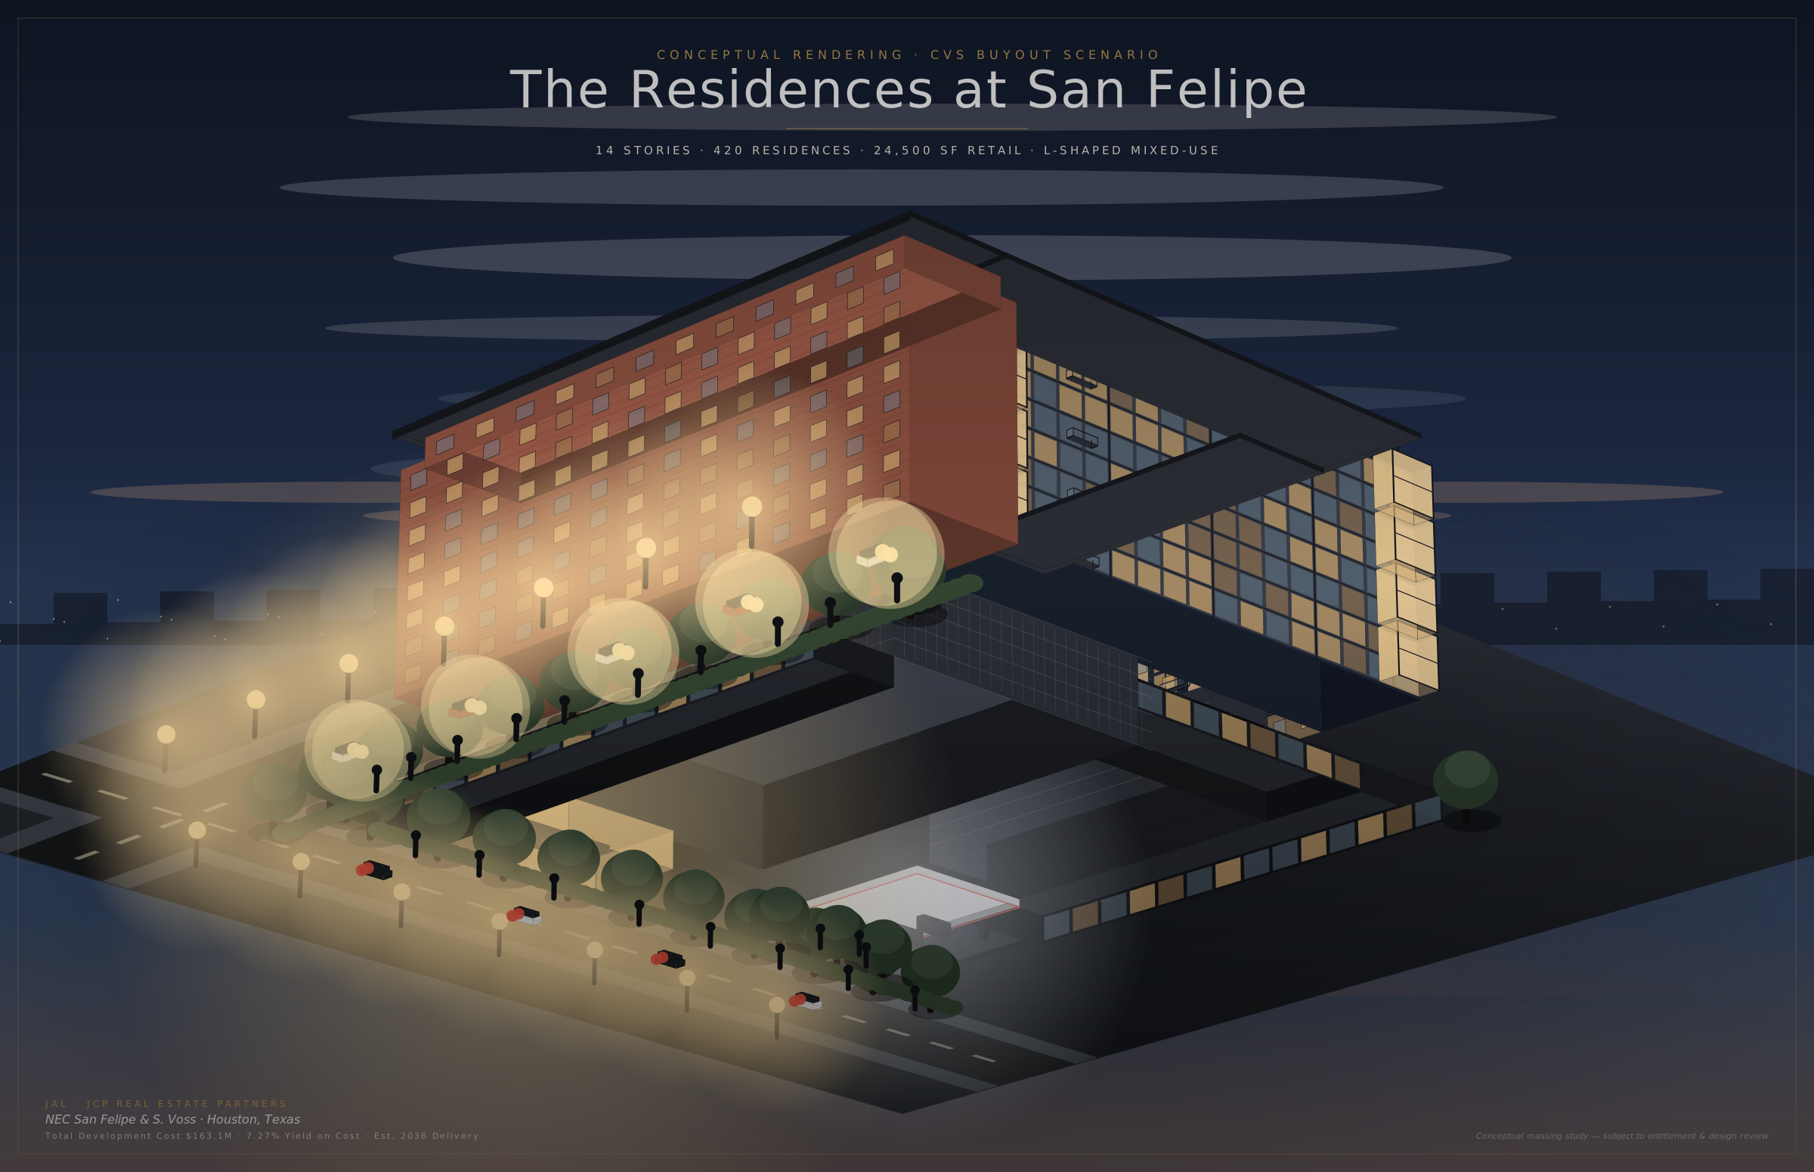
05
EXIT THESIS
Development Vision — The Next Buyer
Illustrative — what the next buyer could build after our exit — The Residences at San Felipe (14-Story Mixed-Use).
BUILDING PROGRAM
Total Height
14 Stories
Net Rentable
353,005 SF
Units
449
Avg Unit Size
725 SF
Rent/SF/Mo
$4.90
Rent/Unit/Mo
$3,552
Parking
660 (1.48/unit)
Retail
24,500 SF @ $45 NNN
Amenities
Pool, Fitness, Dog Run
Conceptual rendering — for illustrative purposes only
JAL-JCP REAL ESTATE PARTNERS
SHOPPES AT SAN FELIPE | MAY 2026
10

Slide 13
05
EXIT THESIS
Next Buyer Economics — Post-Exit
Developer pro forma at exit validates the land-value thesis. MF development occurs after our sale — sponsor controls exit timing.
19.2%
2.78x
$255.4M
28.8%
DEVELOPER IRR
EQUITY MULTIPLE
STABILIZED VALUE
PROFIT MARGIN
TOTAL DEVELOPMENT COST
STABILIZED OPERATIONS
Land (+ 1.5% close)
$60,218,529
MF Gross Potential Rev
$19,140,870
CVS Buyout
$2,202,971
Vacancy & Loss (7%)
($1,339,861)
Demo & Site Prep
$1,328,352
Other Income
$987,800
Hard Costs ($220/SF)
$91,366,044
Retail (NNN)
$1,183,619
Soft Costs (22%)
$20,100,530
EGI
$19,972,428
FF&E ($5K/unit)
$2,245,000
OpEx (36.4%)
($7,195,530)
Dev Fee (4%)
$4,458,663
Stabilized NOI
$12,770,454
Contingency (5%)
$4,568,302
Dev Yield
6.4%
Financing/Carry
$11,748,769
Stab Value (5.0% Cap)
$255,409,077
Total Dev Cost
$198,237,159
Value/Unit
$568,840
Cost/Unit
$441,508
JAL-JCP REAL ESTATE PARTNERS
SHOPPES AT SAN FELIPE | MAY 2026
11

Slide 14
06
UPSIDE
Value-Add Opportunities
Underwritten hold unlocks multiple upside levers beyond base-case projections — sponsor retains full discretion on exit timing.
PAD SITE DEVELOPMENT
TENANT UPGRADES & LEASE-UP
4.54-acre site has excess parking and underutilized frontage along San Felipe
Potential to carve 2–3 outparcel pads for QSR, bank, or medical tenants
Ground leases at $35–50/SF generate $200–400K incremental NOI
Pad site income is additive to land value at exit
Current rents ~21% below market — mark-to-market adds $471K NOI
Re-tenant smaller suites (1,000–2,500 SF) to higher-credit operators
Target food & beverage, medical, and service tenants for premium rents
Push occupancy from 95.2% to 98%+ with targeted leasing
PHYSICAL IMPROVEMENTS
STRATEGIC ACQUISITIONS & EXIT
Façade refresh, signage upgrades, and monument sign on San Felipe
LED parking lot lighting and landscape improvements
Modernize common areas to attract higher-quality tenants
Budgeted at $36K/yr CapEx reserve — major projects self-funded
Opportunity to purchase hard corner Texaco gas station — expands site for development
Assemblage creates larger, more valuable MF development parcel
Pre-entitle for mixed-use to command premium land price at exit
Competitive tension among developers in Houston's hottest corridor
JAL-JCP REAL ESTATE PARTNERS
SHOPPES AT SAN FELIPE | MAY 2026
12

Slide 15
07
RETURNS
LP Cash Flow to 3.11x Equity Multiple
$14.0M invested / $43.5M returned — Pre-exit distributions plus modeled land-sale exit.
 | YR 1 | YR 2 | YR 3 | YR 4 | YR 5 | YR 6 | YR 7 | YR 8 | YR 9 | YR 10 | TOTAL
Net Operating Dist. | $668K | $748K | $627K | $752K | $884K | $1,012K | $1,174K | $891K | $1,051K | $1,128K | $8,935K
Refi Cash-Out | — | — | — | — | $7,736K | — | — | — | — | — | $7,736K
Total LP Pre-Exit | $668K | $748K | $627K | $752K | $8,620K | $1,012K | $1,174K | $891K | $1,051K | $1,128K | $16,671K
Cash-on-Cash | 5.14% | 5.75% | 4.82% | 5.78% | 6.80% | 7.78% | 9.03% | 6.85% | 8.08% | 8.68% | Avg 12.8%
% Equity Back | 4.8% | 10.1% | 14.6% | 20.0% | 81.5% | 88.8% | 97.2% | 103.5% | 111.0% | 119.1%
3.11x
MODELED EXIT — THROUGH LP WATERFALL
LP EQUITY MULTIPLE
Land Sale (197,762 SF × $300/SF)
$59,328,600
15.73%
Less: Loan Payoff
($25,374,931)
Less: Disposition Costs (2.0%)
($1,186,572)
LP IRR (NET)
Net Sale Proceeds
$32,767,097
Pre-Exit Distributions (model)
$16,670,858
$43.5M
Total Distributable
$50,010,191
TOTAL LP DISTRIBUTIONS
Tier 1: Return of Capital
$14,000,000
Tier 2: Pref to 1.25x
$3,500,000
119.1%
Tier 3: 80% of Remaining
$26,008,153
LP Total Distributions
$43,508,153
EQUITY RETURNED PRE-EXIT
JAL-JCP REAL ESTATE PARTNERS
SHOPPES AT SAN FELIPE | MAY 2026
13

Slide 16
07
RETURNS
Tax-Advantaged Returns
Commercial real estate's tax shield materially enhances after-tax LP economics.
§ 01 · DEPRECIATION SHELTER
§ 02 · PASS-THROUGH STRUCTURE
§ 03 · TAX-EFFICIENT EXIT
Paper losses offset cash distributions.
K-1 economics flow directly to LPs.
Land sale at capital-gain rates.
39-Year Straight-Line
LP / LLC Entity
LTCG on Appreciation
Non-cash deduction on improvements basis, annually
No entity-level federal income tax
Land gain at ~23.8% federal (20% + 3.8% NIIT)
Cost Segregation Study
Annual Form K-1
§1250 Recapture Cap
Carves 15–25% of basis into 5 / 7 / 15-yr lives
Allocable share of income, loss, and depreciation
Depreciation recapture capped at 25% on real property³
Bonus Depreciation
Passive Loss Utilization
1031 Exchange Option
First-year write-off on qualifying short-life assets¹
Offsets paper losses against other passive income
Sponsor may structure like-kind exchange to defer
Interest Deduction
§199A QBI Deduction
Texas — 0% State Tax
Senior debt interest fully deductible (RE election)
Up to 20% on qualified pass-through income²
vs. CA 13.3% · NY 10.9% · IL 4.95%
Combined Effect
No Phantom Income
After-Tax IRR Uplift
Tax losses likely in early years despite positive cash flow
Distributions generally track cash, not taxable income
Materially improves effective LP yield vs. taxable comp
CONSULT YOUR TAX ADVISOR
Tax treatment of an LP investment depends on the investor's individual circumstances, entity structure, and changes in law. Projections assume current federal rules; nothing herein constitutes tax advice. ¹Bonus % per current law. ²§199A subject to income thresholds. ³Recapture applies only to depreciation taken.
JAL-JCP REAL ESTATE PARTNERS
SHOPPES AT SAN FELIPE | MAY 2026
14

Slide 17
08
SENSITIVITY
Sensitivity Analysis — Land Price
LP IRR (net of fees and promote) across a range of exit land prices.
LP RETURNS BY LAND SALE PRICE ($/SF)
 | $200 | $225 | $250 | $275 | $300 | $325 | $350 | $375 | $400
LP IRR | 10.5% | 12.1% | 13.4% | 14.6% | 15.7% | 16.7% | 17.6% | 18.5% | 19.3%
LP Multiple | 2.00× | 2.28× | 2.55× | 2.83× | 3.11× | 3.38× | 3.66× | 3.94× | 4.22×
Gross Exit Value | $39.6M | $44.5M | $49.4M | $54.4M | $59.3M | $64.3M | $69.2M | $74.2M | $79.1M
BASE CASE $300/SF → 15.7% LP IRR / 3.11× EM Even at $250/SF (17% below base), LP IRR holds 13.4% with a 2.55× multiple.
LAND PRICE SUPPORTED AT 19.2% DEVELOPER IRR / BY MF RENT
MF Rent/SF/Mo | $4.25 | $4.50 | $4.70 | $4.90 | $5.10 | $5.30
Land $/SF (19.2% Dev IRR) | $217 | $243 | $274 | $300 | $328 | $355
LP IRR at That Price | 10.8% | 12.5% | 14.1% | 15.7% | 16.8% | 17.9%
LP Multiple | 2.22x | 2.53x | 2.90x | 3.11x | 3.54x | 3.86x
JAL-JCP REAL ESTATE PARTNERS
SHOPPES AT SAN FELIPE | MAY 2026
15

Slide 18
08
SENSITIVITY
Sensitivity Analysis — Hold Period
Project (gross) and LP (net of fees and promote) returns across alternative exit timing and structures.
RETURNS BY EXIT SCENARIO · PROJECT (GROSS) & LP (NET)
EXIT SCENARIO | BASE 10-YR / $300/SF | 2A · 5-YR · $246/SF (MF Developer) | 2B · 5-YR · 5.5% Cap (REIT)
Project IRR (gross) | 18.27% | 21.13% | 17.90%
Project equity multiple | 3.70× | 2.45× | 2.15×
LP IRR (net) | 15.73% | 17.72% | 14.89%
LP equity multiple | 3.11× | 2.16× | 1.92×
TARGET CASE 5-yr / $246/SF · MF Developer → 21.13% Project IRR / 2.45x EM (17.72% LP IRR / 2.16x net of promote)
EXIT MECHANICS — DOLLARS RECOVERED / PER SCENARIO
EXIT MECHANICS | BASE 10-YR / $300 | 2A · 5-YR · $246 (MF Developer) | 2B · 5-YR · 5.5% Cap (REIT)
Gross sale price | $59,328,600 | $48,649,452 | $44,357,000
Net sale proceeds | $32,767,097 | $28,932,025 | $24,725,422
Implied cap rate | 4.75% | 4.75% | 5.50%
JAL-JCP REAL ESTATE PARTNERS
SHOPPES AT SAN FELIPE | MAY 2026
16

Slide 19
08
SENSITIVITY
Sensitivity Analysis — CVS Parcel Strategies
Standalone monetization paths for the 1.48-acre / 64,417 SF CVS parcel — sell or contribute to MF developer.
CVS PARCEL STRATEGIES · PROJECT (GROSS) & LP (NET)
EXIT SCENARIO | BASE 10-YR / $300/SF (MF Developer) | SCENARIO 3 — CVS YR7 SALE (MF Developer) | SCENARIO 4 — CONTRIBUTION (Ride-Along Equity)
Project IRR (gross) | 18.27% | 19.60% | 19.71%
Project equity multiple | 3.70× | 3.37× | 4.21×
LP IRR (net) | 15.73% | 17.15% | 17.11%
LP equity multiple | 3.11× | 2.85× | 3.52×
TARGET CASE S3B — CVS Land Contribution → 19.71% Project IRR / 4.21x EM (17.11% LP IRR / 3.52× net of promote)
EXIT MECHANICS — KEY ASSUMPTIONS / PER SCENARIO
EXIT MECHANICS | BASE 10-YR / $300/SF | SCENARIO 3 (CVS Sale Yr7 + Y10 Remaining) | SCENARIO 4 (Contribution + Y10 Both)
Gross sale price | $59,328,600 | $56.1M ($16.1M Y7 + $40.0M Y10) | $56.1M + $27.3M land equity
Net sale proceeds | $32,767,097 | $33.3M ($15.78M Y7 + $17.52M Y10) | $60.6M (incl. $27.3M dev equity)
Land basis ($/SF) | $300/SF (full assemblage) | $250 CVS · $300 remaining | $250 CVS · $300 remaining
JAL-JCP REAL ESTATE PARTNERS
SHOPPES AT SAN FELIPE | MAY 2026
17

Slide 20
08
SENSITIVITY
Sensitivity Analysis — Stress Test
LP returns under adverse scenarios with debt coverage analysis.
DOWNSIDE SCENARIOS
SCENARIO | LAND $/SF | EXIT VALUE | LP IRR | LP MULTIPLE | IMPACT VS BASE
Base Case | $300 | $59.3M | 15.73% | 3.11× | —
Land −17% | $250 | $49.4M | 13.4% | 2.55× | -2.3pp IRR
Land −33% | $200 | $39.6M | 10.5% | 2.00× | -5.3pp IRR
5-Yr Hold (Sell Yr 5) | $275 | $54.4M | 21.0% | 2.47× | +5.2pp IRR
NOI −10% (all years) | $300 | $59.3M | 13.9% | 2.99× | -1.8pp IRR
Refi Rate 6.5% | $300 | $59.3M | 14.9% | 2.98× | -0.8pp IRR
No Refinance | $300 | $59.3M | 13.8% | 3.16× | -1.9pp IRR
DEBT SERVICE COVERAGE RATIO BY YEAR
 | Yr 1 | Yr 2 | Yr 3 | Yr 4 | Yr 5 | Yr 6 | Yr 7 | Yr 8 | Yr 9 | Yr 10
NOI | $1,982K | $2,071K | $2,181K | $2,305K | $2,440K | $2,485K | $2,648K | $2,750K | $2,917K | $2,994K
Debt Svc | $1,182K | $1,182K | $1,412K | $1,412K | $1,412K | $1,331K | $1,331K | $1,714K | $1,714K | $1,714K
DSCR | 1.68x | 1.75x | 1.54x | 1.63x | 1.73x | 1.87x | 1.99x | 1.60x | 1.70x | 1.75x
Min DSCR: 1.54x (Yr 3) / All years exceed 1.25x SouthState covenant
JAL-JCP REAL ESTATE PARTNERS
SHOPPES AT SAN FELIPE | MAY 2026
18

Slide 21
09
RISK
Risk Factors & Mitigants
RISK FACTOR
MITIGANT
Tenant Turnover
Diverse 21-tenant roster with 95.2% occupancy and 5.77-year WALT. No single tenant (ex-CVS) exceeds 13% of revenue.
Below-Market Rent
Current rents ~21% below market — creates natural upside buffer. Mark-to-market adds $471K to NOI without any new tenants.
Land Value Compression
Even at $225/SF (3.2% annual growth, well below Houston's 5–7% average), LP IRR is still 12.1% with a 2.28× multiple.
Interest Rate / Refi Risk
Conservative 60% LTV with DSCR ≥ 1.54x (Yr 3 trough). No-refi scenario still yields 13.8% LP IRR.
Property Tax Reassessment
HCAD reassessment risk offset by triple-net recovery structure — taxes are passed through to tenants under existing leases.
Insurance / Storm Exposure
Houston Gulf Coast location mitigated by concrete tilt-wall construction, flood zone X (minimal risk), and NNN expense recovery.
Zoning / Deed Restrictions
Confirmed NO deed restrictions. Standalone commercial plat. Houston Ch. 42 — no height limits on this parcel.
JAL-JCP REAL ESTATE PARTNERS
SHOPPES AT SAN FELIPE | MAY 2026
19

Slide 22
10
THE SPONSOR
JAL-JCP Real Estate Partners
Institutional discipline. Operator-driven execution.
— THE PARTNERSHIP
JAL-JCP is a partnership between Justin A. Levine and James C. Pappas focused on acquiring retail real estate with durable cash flow and long-term value creation. Combined experience spans private real estate, public markets, and institutional capital formation.
Strategy centers on unanchored strip centers — acquired below replacement cost, underwritten to in-place cash flow, and held with conservative leverage for downside protection.
COMBINED EXPERIENCE
43+ yrs
$900M+
combined experience
invested & managed
3.9M SF
$2.5B+
across 26 assets
institutional equity raised
— HOW WE OPERATE
01
02
03
Partnership & Leadership
Strategy & Market Focus
Investor Alignment
· Longstanding collaboration across CRE
· Complementary backgrounds: private RE, public markets, capital formation
· Institutional discipline · operator-driven execution
· Private real estate with long-term value creation
· Primary emphasis on unanchored strip centers
· "Cash-flow day one" — acquire below replacement cost
· Flexible: deal-by-deal, SMA, or programmatic venture
· Modest leverage — capped at ~60% LTV
· Operate assets directly — no double-promote structures
JAL-JCP REAL ESTATE PARTNERS
SHOPPES AT SAN FELIPE | MAY 2026
20

Slide 23
10
THE SPONSOR
Justin A. Levine
JAL-JCP Real Estate Partners · jlevine@jalstrategies.com
20+ yrs
$600M
3.9M SF
$2.5B
COMMERCIAL REAL ESTATE
INVESTED/MANAGED AT LEVCOR
ACROSS 26 ASSETS (TX & NC)
EQUITY RAISED AT BLACKSTONE
Former President of Levcor, Inc., a full-service national CRE firm that has developed, owned, or managed 25M sf of real estate. At Levcor (2014–2025) served as President, SVP/CIO, and VP.
Helped invest and/or manage $600M across 26 assets and 3.9M sf in Texas and North Carolina — delivering a 4.13× realized equity multiple and 16.1% realized IRR across six exited assets, with an additional twenty active assets carrying an estimated 3.36× total equity multiple as of underwriting.
Previously at The Blackstone Group (2006–2011) in New York, where he helped raise ~$2.5B of institutional equity for global real estate platforms across 15 private-equity advisory assignments. Active member of the Urban Land Institute.
EDUCATION & AFFILIATIONS
· M.B.A., The Wharton School of Business
· B.S. Economics & Communication Studies, Northwestern University
· Urban Land Institute (ULI) — Member; former Houston District Council Chair (2022–24)
· ICSC member · Licensed Texas real estate salesperson
— TRACK RECORD AT LEVCOR, INC.
REALIZED · 6 EXITED ASSETS
UNREALIZED · 20 ACTIVE ASSETS
4.13×
realized equity multiple
Northwest Mall · UTMB
3.36×
est. total equity multiple
3.9M SF
16.1% realized IRR
Village @ West Oaks · Sherman
$600M invested & managed
TX & NC portfolio
JAL-JCP REAL ESTATE PARTNERS
SHOPPES AT SAN FELIPE | MAY 2026
21

Slide 24
10
THE SPONSOR
James C. Pappas
JAL-JCP Real Estate Partners · jcp@jcpinv.com
17+ yrs
$250M+
$50M+
10+
PUBLIC RE & CREDIT
DISCRETIONARY CAPITAL AT JCP
CO-INVEST RAISED
PUBLIC-COMPANY BOARDS SERVED
Founded JCP Investment Management in June 2009 — a value-based, SEC-registered investment firm operating across equity, credit, and distressed securities, primarily in North America.
Currently serves on the board of Tandy Leather Factory (NASDAQ: TLF). Prior board seats: Jamba Inc., U.S. Geothermal, The Pantry, and Chairman of Morgan’s Foods — several taken private or sold at a premium.
Previously with The Goldman Sachs Group (Investment Banking / Leveraged Finance) and Banc of America Securities (Consumer & Retail Investment Banking).
EDUCATION & AFFILIATIONS
· M.S. Finance, Texas A&M University
· B.B.A., Texas A&M University
· Houston Methodist Gastrology Board
· Endowment Board — Houston Greek Orthodox Church
JCP Investment Management is not the sponsor, manager, or investment adviser of this offering.
— TRACK RECORD AT JCP INVESTMENT MANAGEMENT
JCP INVESTMENT MANAGEMENT · SINCE 2009
PUBLIC-COMPANY GOVERNANCE
$250M+
discretionary capital deployed
17+ yrs
10+
public-company boards
Chairman
$50M+ co-invest raised
public RE & credit
Current: NASDAQ: TLF
Morgan’s · Jamba · Pantry
JAL-JCP REAL ESTATE PARTNERS
SHOPPES AT SAN FELIPE | MAY 2026
22

Slide 25
11
THESIS
Investment Thesis
01
02
03
ACQUIRE
OPERATE
EXIT
YEAR 0
HOLD PERIOD
AT DISCRETION
$31.75M / $163/SF land basis
$1.89M Year 1 NOI
Land sale at $300/SF (model)
$14.0M LP equity ($13M basis + $1M escrow) / 42% LTV
Yr 5 refi / 55.3% equity returned (MTM-lifted)
$59.3M gross / $32.8M net
5.94% going-in cap
8.2% avg levered cash-on-cash
18.27% project IRR
Below replacement cost
$10.68M modeled operating CF (10-yr)
15.7% LP IRR / 3.11x multiple
THE THESIS
Off-market acquisition of income-producing real estate at raw land value in Houston's best corridor. Modeled land-sale exit at $300/SF delivers 15.7% LP IRR / 2.98× EM. Underwriting reflects SouthState $19.5MM @ 6.06% + $14MM equity inclusive of $1MM sponsor TI/LC self-escrow. Sponsor retains full discretion on exit timing and form.
JAL-JCP REAL ESTATE PARTNERS
SHOPPES AT SAN FELIPE | MAY 2026
23

Slide 26
JAL-JCP REAL ESTATE PARTNERS
THE SHOPPES AT
SAN FELIPE
OFF-MARKET INVESTMENT OFFERING / $31,750,000
JUSTIN A. LEVINE
JAMES C. PAPPAS
JAL-JCP Real Estate Partners
JAL-JCP Real Estate Partners
jlevine@jalstrategies.com
jcp@jcpinv.com
CONFIDENTIAL — For informational purposes only. Does not constitute an offer to sell or solicitation of an offer to buy any securities. All projections based on assumptions that may not be realized.

