Slide 1
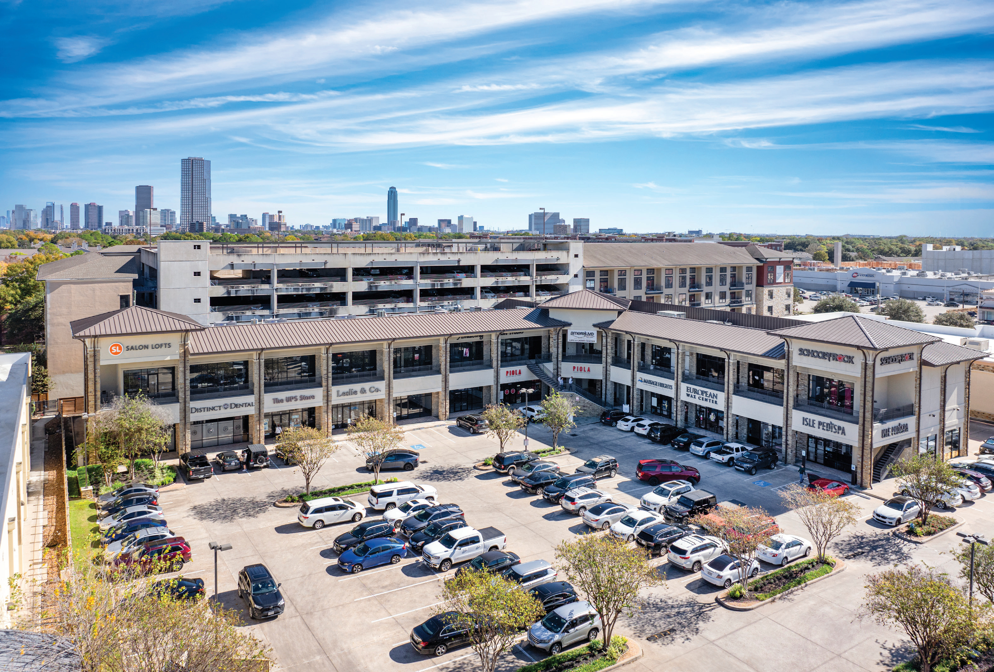
JAL-JCP REAL ESTATE PARTNERS
THE SHOPPES AT
SAN FELIPE
OFF-MARKET INVESTMENT OFFERING
61,196
4.54
95.2%
SF RETAIL
ACRES
OCCUPIED
NEC SAN FELIPE & S. VOSS | HOUSTON, TEXAS 77057
PREPARED FOR BELAY INVESTMENT GROUP
MAY 2026

Slide 2
00
DISCLOSURE
Notice to Investors
The information contained herein is provided to you for information purposes only, is unaudited, and is not, and may not be relied on in any manner as, legal, tax or investment advice. Prospective investors should consult with their own legal, tax and financial advisers as to the consequences of an investment. These materials have been prepared as a means to provide information to investors interested in certain investments managed by JAL-JCP Real Estate Partners, LLC (“JAL-JCP”) which will be advised by JCP Investment Management, LLC (“JCPIM”).
Investment will involve significant risks, including risk of loss of the entire investment. Before deciding to invest, prospective investors should pay particular attention to the risk factors associated including but not limited to: (i) an investment in real estate assets may result in a loss of investment; (ii) dependence on key personnel may result in additional operational risk; and (iii) the investment will be managed exclusively by JAL-JCP and (iv) JCPIM and/or an affiliated entity will be advising JAL-JCP. Investors should have the financial ability and willingness to accept the risk characteristics of the discussed investment.
The information contained herein must be kept strictly confidential and may not be reproduced or redistributed in any format without JAL-JCP’s express written approval. Certain information contained herein has been obtained from published and non-published sources and has not been independently verified by JAL-JCP. Except where otherwise indicated, the information provided herein is based on matters as they exist as of the date of preparation and not as of any future date and will not be updated to reflect information that subsequently becomes available.
Certain information contained herein constitutes “forward-looking statements,” which can be identified by the use of forward-looking terminology such as “may,” “will,” “seek,” “should,” “expect,” “anticipate,” “project,” “estimate,” “intend,” “continue” or “believe” or the negatives thereof. Due to various risks and uncertainties, actual events or results may differ materially from those reflected or contemplated in such forward-looking statements.
Unless otherwise stated, all projected rates of return are presented on a “gross” basis (i.e., they do not reflect the “promote,” taxes and other expenses to be borne by investors, which in the aggregate could be substantial). Past performance can be no assurance of future results.
This document is for informational purposes only. It does not constitute an offer to sell or the solicitation of an offer to buy any interest in a security. Investments should only be made by investors who fully understand these risks and can withstand a loss of their entire investment.
JAL-JCP REAL ESTATE PARTNERS
SHOPPES AT SAN FELIPE | MAY 2026
i

Slide 3
01
OVERVIEW
Financial Overview
ACQUISITION & BASIS
FINANCING
OPERATIONS
Purchase Price
$31,750,000
Debt Financing Advisor
Walker & Dunlop
Year 1 NOI
$1,887,280
Acq Fee + Closing (2.36%)
$750,000
Loan Amount
$19,500,000
Year 5 NOI
$2,084,487
Total Basis
$32,500,000
LTV
60.0%
Year 10 NOI
$2,286,285
Land Area (SF)
197,762
Interest Rate
5.50%
NOI CAGR (Y1–Y10)
2.16%
Building Area (SF)
61,196
Term
5 years
Occupancy (in-place)
95.2%
Going-in Basis (Land)
$160.55 / SF
IO Period
2 years
CapEx Reserve
$36K / yr
Going-in Basis (Bldg)
$518.82 / SF
Amortization (after IO)
30 years
Going-in Cap Rate
5.94%
Equity Required
$13,000,000
JAL-JCP REAL ESTATE PARTNERS
SHOPPES AT SAN FELIPE | MAY 2026
1

Slide 4
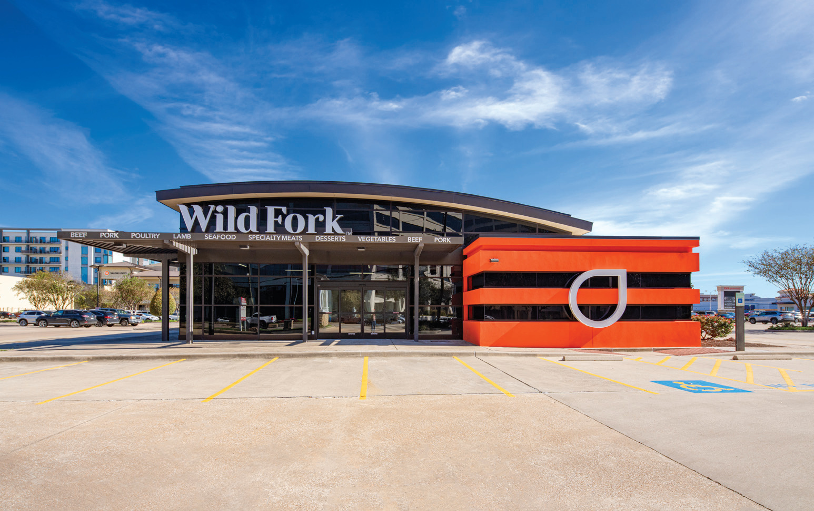
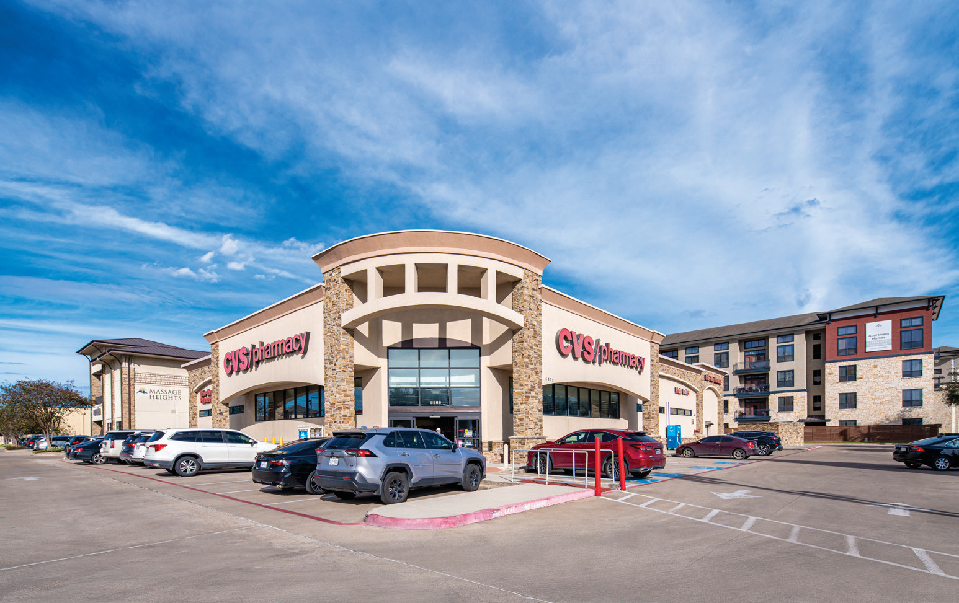
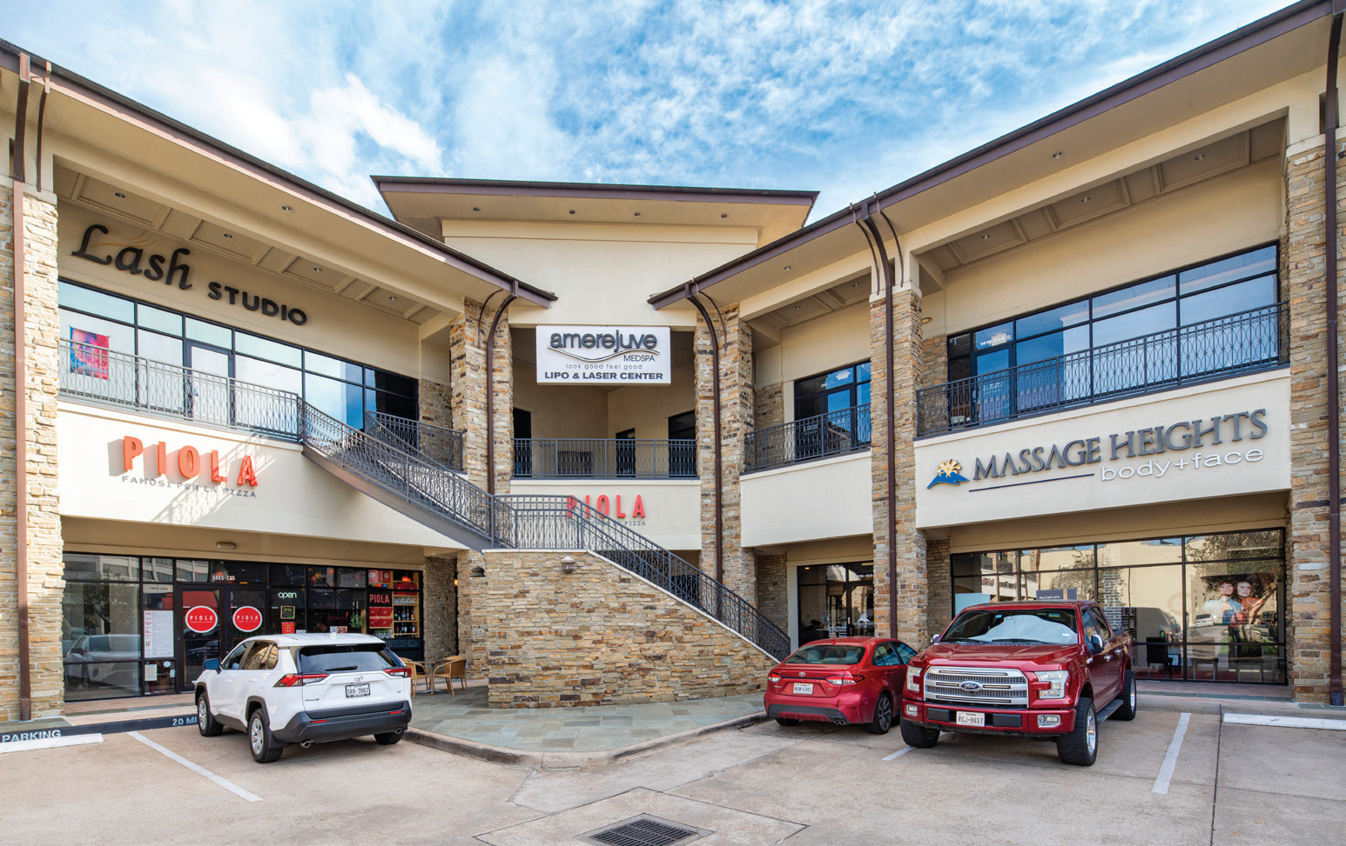
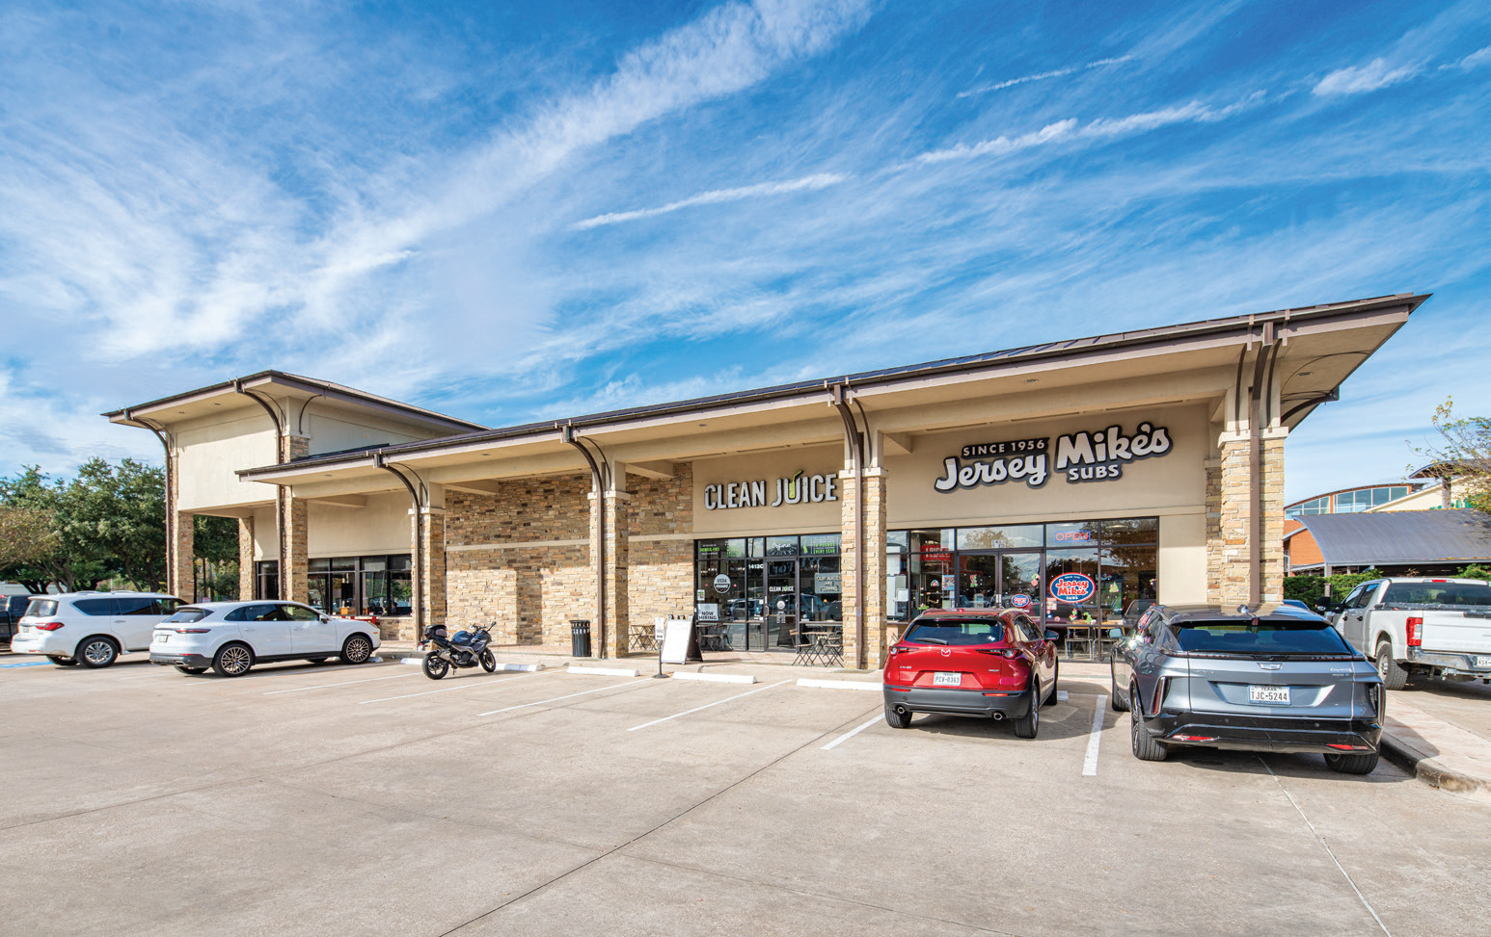
02
PROPERTY
Property Overview
Wild Fork Foods
CVS Pharmacy
East Wing
North Wing
JAL-JCP REAL ESTATE PARTNERS
SHOPPES AT SAN FELIPE | MAY 2026
2

Slide 5
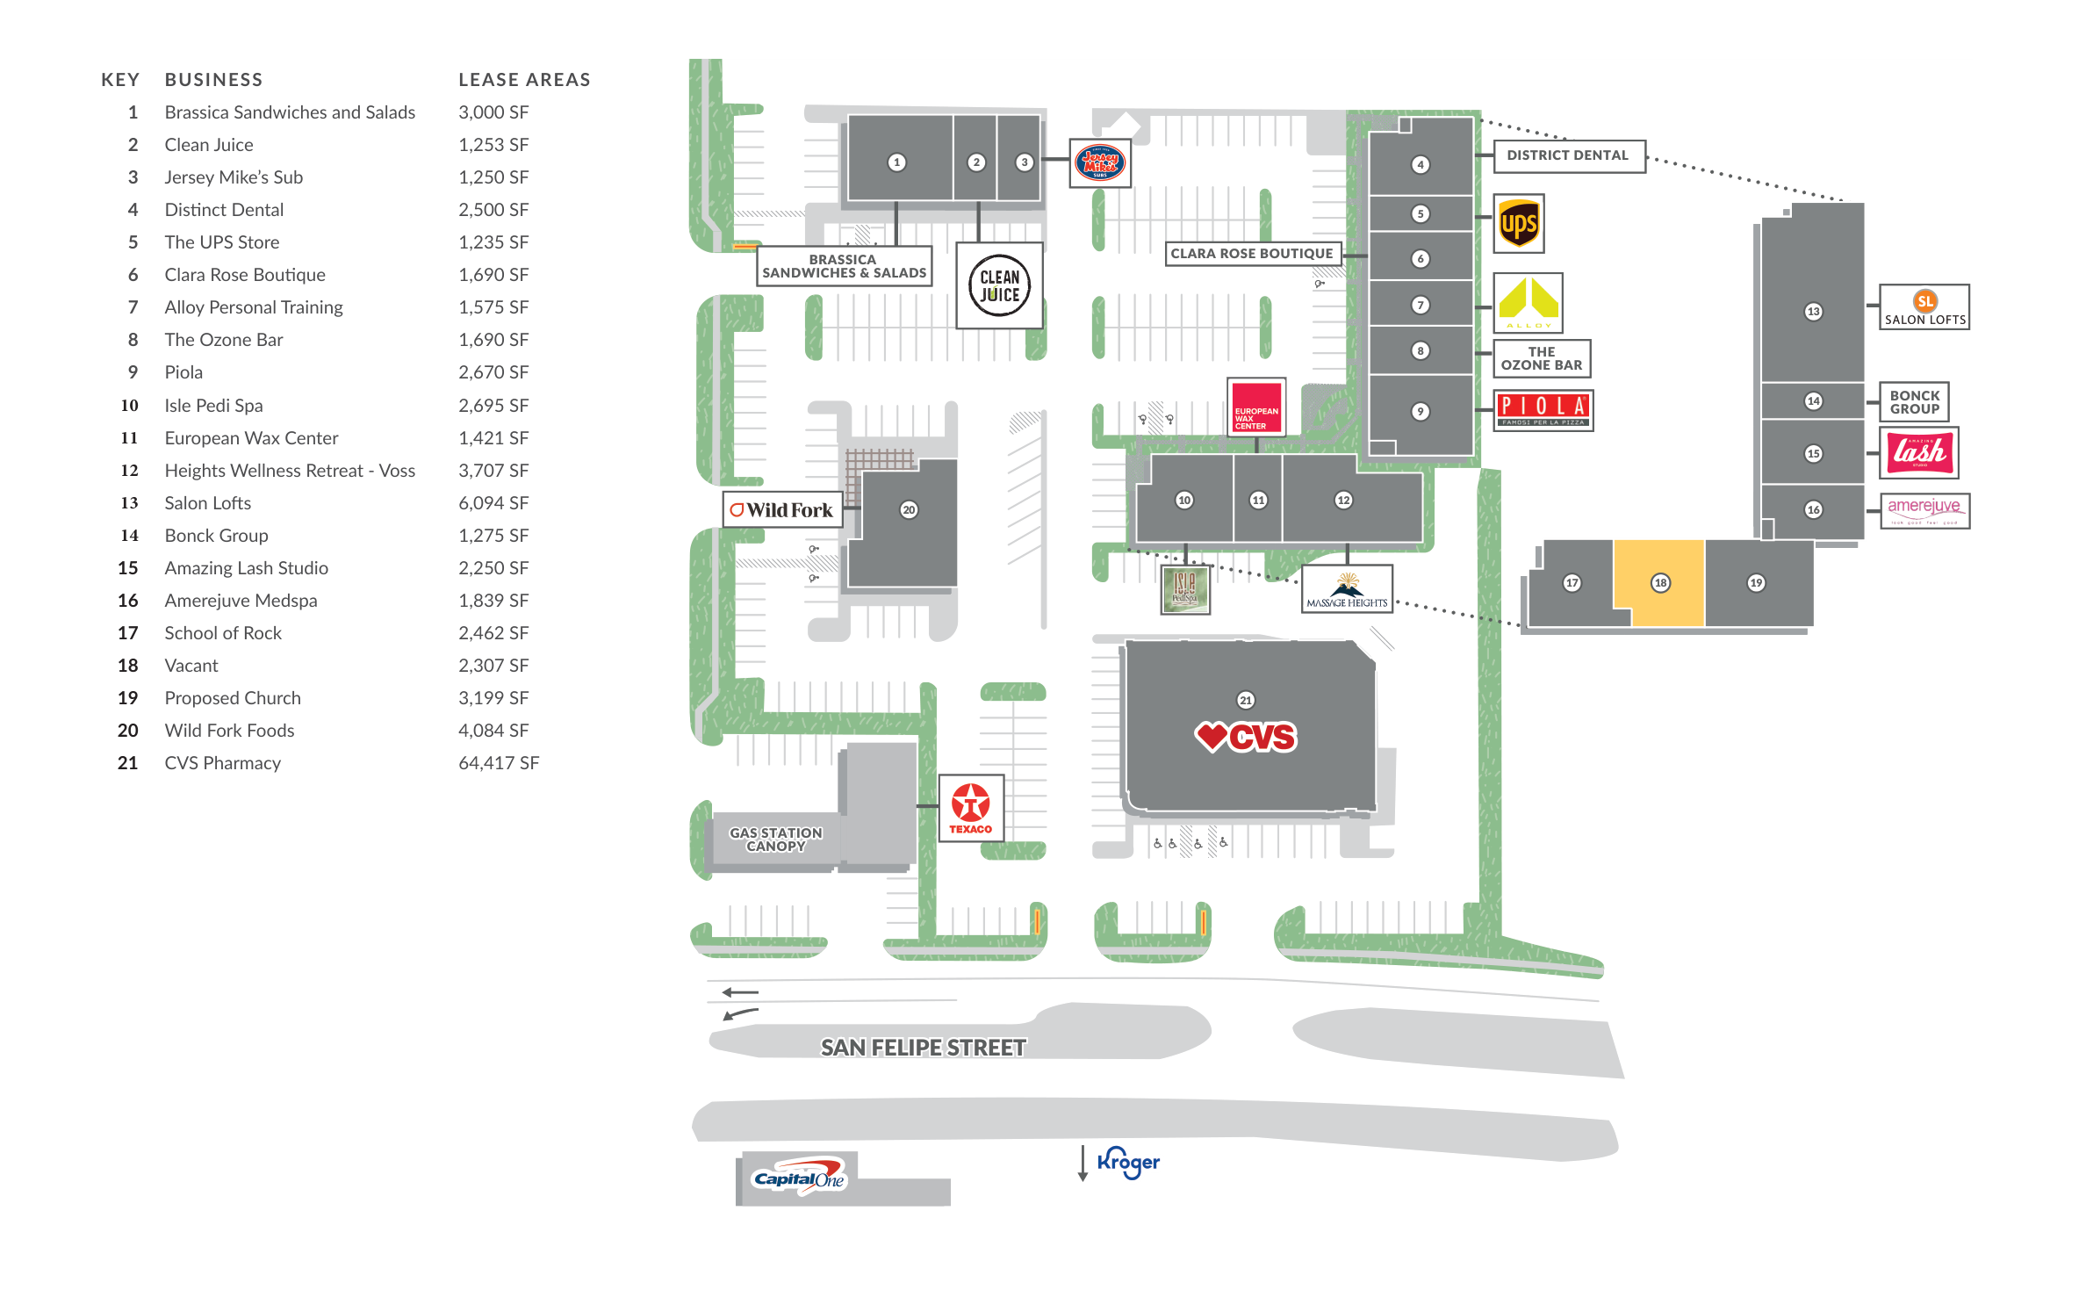
02
PROPERTY
Site Plan
61,196 SF retail center on 4.54 acres at the NEC of San Felipe & S. Voss.
JAL-JCP REAL ESTATE PARTNERS
SHOPPES AT SAN FELIPE | MAY 2026
3

Slide 6
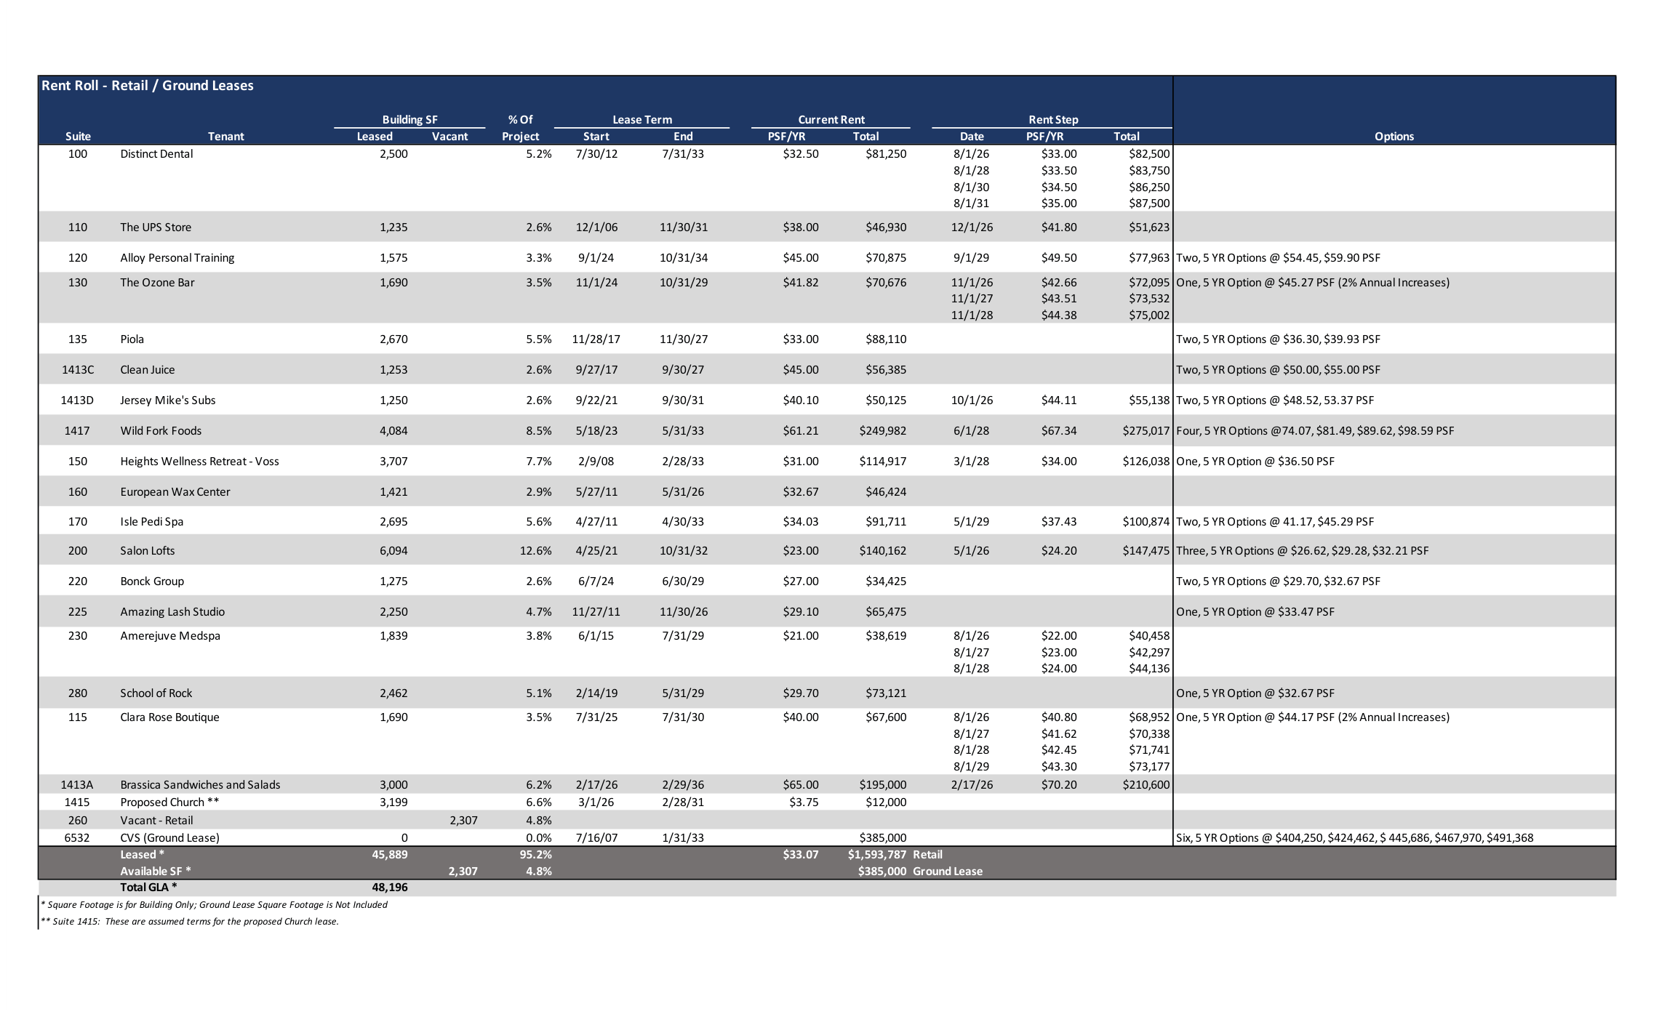
02
PROPERTY
Rent Roll
21 tenants / 95.2% occupied / WALT 5.77 yrs / $1.98M Yr 1 in-place rent
SUITE | TENANT | SF | % GLA | LEASE END | PSF | ANNUAL RENT | NOTES / OPTIONS
100 | Distinct Dental | 2,500 | 5.2% | 7/31/33 | $32.50 | $81,250 | Steps to $35 PSF by 2031
110 | The UPS Store | 1,235 | 2.6% | 11/30/31 | $38.00 | $46,930 | Steps to $41.80 PSF (12/26)
115 | Clara Rose Boutique | 1,690 | 4.3% | 7/31/30 | $40.00 | $67,600 | 2% annual · One 5-yr opt @ $44.17
120 | Alloy Personal Training | 1,575 | 3.3% | 10/31/34 | $45.00 | $70,875 | Two 5-yr opts @ $54.45, $59.90
130 | The Ozone Bar | 1,690 | 4.3% | 10/31/29 | $41.82 | $70,676 | 2% annual · One 5-yr opt @ $45.27
135 | Piola | 2,670 | 5.5% | 11/30/27 | $33.00 | $88,110 | Two 5-yr opts @ $36.30, $39.93
150 | Heights Wellness Retreat | 3,707 | 7.7% | 2/28/33 | $31.00 | $114,917 | One 5-yr opt @ $36.50
160 | European Wax Center | 1,421 | 2.9% | 5/31/26 | $32.67 | $46,424 | Expiring · 2026 mark-to-market
170 | Isle Pedi Spa | 2,695 | 5.6% | 4/30/33 | $34.03 | $91,711 | Two 5-yr opts @ $41.17, $45.29
200 | Salon Lofts | 6,094 | 13.1% | 10/31/32 | $23.00 | $140,162 | Three 5-yr opts to $32.21
220 | Bonck Group | 1,275 | 2.6% | 6/30/29 | $27.00 | $34,425 | Two 5-yr opts @ $29.70, $32.67
225 | Amazing Lash Studio | 2,250 | 4.7% | 11/30/26 | $29.10 | $65,475 | Expiring · 2026 mark-to-market
230 | Amerejuve Medspa | 1,839 | 3.8% | 7/31/29 | $21.00 | $38,619 | Steps to $24 PSF by 2028
260 | Vacant — Retail | 2,307 | 4.8% | — | — | — | Available for lease
280 | School of Rock | 2,462 | 6.1% | 5/31/29 | $29.70 | $73,121 | One 5-yr opt @ $32.67
1413A | Brassica Sandwiches & Salads | 3,000 | 6.2% | 2/29/36 | $65.00 | $195,000 | New lease · steps to $70.20
1413C | Clean Juice | 1,253 | 2.6% | 9/30/27 | $45.00 | $56,385 | Two 5-yr opts @ $50.00, $55.00
1413D | Jersey Mike's Subs | 1,250 | 2.6% | 9/30/31 | $40.10 | $50,125 | Two 5-yr opts @ $48.52, $53.37
1415 | Proposed Church | 3,199 | 6.6% | 2/28/31 | $3.75 | $12,000 | ** Assumed terms (proposed)
1417 | Wild Fork Foods | 4,084 | 8.5% | 5/31/33 | $61.21 | $249,982 | Four 5-yr opts to $98.59
6532 | CVS Pharmacy (Ground Lease) | 13,000 | — | 1/31/33 | — | $385,000 | ~13K SF on 1.31 ac · escalates to $491K
 | Retail subtotal (leased) | 45,889 | 95.2% |  | $34.73 | $1,593,787 | 19 tenants · excludes vacant + CVS
 | TOTAL YR 1 IN-PLACE RENT | 61,196 | 100% |  |  | $1,978,787 | Incl. CVS ground lease ($385K · escalates to $491K)
JAL-JCP REAL ESTATE PARTNERS
SHOPPES AT SAN FELIPE | MAY 2026
4

Slide 7
03
MARKET & LAND
Houston & Memorial Villages
For the investor who has never driven Voss Road — why capital keeps moving into this corridor.
§ 01 · HOUSTON MSA
§ 02 · MEMORIAL VILLAGES
§ 03 · SAN FELIPE & VOSS
4th-largest U.S. metro.
The Greenwich of Texas.
Where it all meets.
MSA Population
Median HH Income
Avg HH Income (1-mi)
7.5M
$250K+
$250K+
U.S. Census 2024 · #5 metro
ACS · Piney Point / Hunters Creek
ESRI / Claritas 2024
10-yr Growth
Median Home Value
Avg HH Income (3-mi)
+20%
$2.3M
$180K+
+1.3M residents since 2014
HAR MLS 2024 · 77024
ESRI / Claritas 2024
MSA GDP
Combined Population
Daytime Pop (3-mi)
$697B
~24,500
250K+
BEA 2023 · 23rd-largest globally
6 incorporated villages
incl. Uptown / Galleria
Fortune 500 HQs
Memorial HS
Traffic — San Felipe
25+
Top 2%
35K VPD
3rd most of any U.S. metro
U.S. News · Texas public
TxDOT count · 2024
State Income Tax
Property Crime
Traffic — S. Voss
0%
−84%
28K VPD
Texas · constitutional
vs. U.S. avg · City-Data
TxDOT count · 2024
Port of Houston
New Retail Supply
Galleria Distance
WHY THIS MATTERS FOR THE DEAL
#1 U.S.
≈ 0
1.2 mi
Adjacent land trades at $225–$350/SF; nearby residential dirt has run to $450+/SF. We are stepping in at $163/SF — the number 2019 appraisals assigned to this dirt.
foreign tonnage · 23 yrs
built-out · deed-restricted
Houston's CBD of retail
JAL-JCP REAL ESTATE PARTNERS
SHOPPES AT SAN FELIPE | MAY 2026

Slide 8
03
MARKET & LAND
Land Comparables
Subject trades at or below raw land value — acquiring 61,196 SF of improvements for free.
COMPARABLE | LOCATION | ACRES | SALE PRICE | $/SF | YEAR | NOTES
7500 San Felipe St | NWC Voss & San Felipe | 2.87 | $20.4M | $163* | 2019 | CapRidge — 168K SF office included
6363 Woodway Dr | Woodway & Bering | 4.0 | $22.6M | $130* | 2019 | CapRidge — 218K SF office included
Tradition at Woodway | 6336 Woodway Dr | 2.6 | $20.4M | $180 | 2018 | Sold to Tradition Senior Living
4702 Westheimer | Adj. River Oaks District | 3.4 | N/A | $225–300 | 2024 | Fertitta — vacant land
BLVD Place / Post Oak | Post Oak Blvd | 6.3 | N/A | $250–350 | 2024 | Goff / Schnitzer / Doggett JV
River Oaks District | 4444 Westheimer | 14.0 | $450M | $738** | 2024 | Fertitta — improved
Tanglewood Residential | Adjacent area | Varies | Various | $453 avg | 2024 | 47 residential lot sales
SHOPPES AT SAN FELIPE | 1415 S. Voss Rd | 4.54 | $31.75M | $163 | 2026 | Subject — buildings included
* HCAD appraised (2019), includes buildings. Today's land-only values 20–30% higher. ** Includes 300K+ SF retail, 67K office, 279 apts.
BUYING AT LAND VALUE
In 2019, the office building across the street appraised at $163/SF with improvements. Our basis matches that — six years later — with $1.89M NOI and 61,196 SF of buildings effectively free.
JAL-JCP REAL ESTATE PARTNERS
SHOPPES AT SAN FELIPE | MAY 2026
6

Slide 9
03
MARKET & LAND
Land Appreciation Thesis
Market data supports a $300/SF exit — and the deal works even at $225/SF. Sponsor retains full discretion on timing.
$163/SF → $300/SF = 6.2% CAGR over the underwritten hold
MARKET DATA
CONSERVATIVE CASE / $225/SF EXIT
Houston Heights Land Values
+64% over 10 years (6.4% annual)
HAR / Redfin
3.2%
40% below
Houston Overall Appreciation
5.4% avg annual (2014–2024)
ZHVI / Census
Tanglewood (Adjacent)
$453/SF avg residential (2024)
HAR MLS
REQUIRED ANNUAL GROWTH
VS. HOUSTON AVG (5.4%)
Tanglewood YoY Growth
+7.3% in 2024 alone
HAR MLS
$44.5M
10.5%
Houston Median $/SF
+4.7% YoY (metro-wide)
Redfin / Zillow
Fertitta / 4702 Westheimer
$225–300/SF vacant land (2024)
HCAD / CoStar
EXIT LAND VALUE
PROJECT IRR (GROSS)
BLVD Place / Post Oak JV
$250–350/SF land basis (2024)
CoStar / Press
2.22x
~$128/SF
PROJECT MULTIPLE
BREAKEVEN LAND $/SF
6.2% ANNUAL GROWTH IS BELOW MARKET TREND
Houston's Inner Loop corridors have averaged 5–7% land appreciation annually. At just 3.2% growth ($225/SF exit), the deal still produces ~10.5% project IRR with a 2.22x multiple — well above hurdle.
JAL-JCP REAL ESTATE PARTNERS
SHOPPES AT SAN FELIPE | MAY 2026
7

Slide 10
04
UPSIDE
Value-Add Opportunities
Underwritten hold unlocks multiple upside levers beyond base-case projections — sponsor retains full discretion on exit timing.
PAD SITE DEVELOPMENT
TENANT UPGRADES & LEASE-UP
4.54-acre site has excess parking and underutilized frontage along San Felipe
Potential to carve 2–3 outparcel pads for QSR, bank, or medical tenants
Ground leases at $35–50/SF generate $200–400K incremental NOI
Pad site income is additive to land value at exit
Current rents ~21% below market — mark-to-market adds $471K NOI
Re-tenant smaller suites (1,000–2,500 SF) to higher-credit operators
Target food & beverage, medical, and service tenants for premium rents
Push occupancy from 95.2% to 98%+ with targeted leasing
PHYSICAL IMPROVEMENTS
STRATEGIC ACQUISITIONS & EXIT
Façade refresh, signage upgrades, and monument sign on San Felipe
LED parking lot lighting and landscape improvements
Modernize common areas to attract higher-quality tenants
Budgeted at $36K/yr CapEx reserve — major projects self-funded
Opportunity to purchase hard corner Texaco gas station — expands site for development
Assemblage creates larger, more valuable MF development parcel
Pre-entitle for mixed-use to command premium land price at exit
Competitive tension among developers in Houston's hottest corridor
JAL-JCP REAL ESTATE PARTNERS
SHOPPES AT SAN FELIPE | MAY 2026
8

Slide 11
04
UPSIDE
Mark-to-Market Analysis · In-Place NOI vs Stabilized Market NOI
Current rents trail Memorial-corridor market by ~21%. Marking to market lifts NOI by $471K and expands the going-in cap by 149 bps — without any capital investment, just natural rollover.
RENT & NOI BUILD · IN-PLACE vs MARKET
NOI BRIDGE & CAP RATE EXPANSION
METRIC
IN-PLACE
MARKET
Δ
YEAR 1 IN-PLACE NOI
MARK-TO-MARKET
STABILIZED MARKET NOI
Multi-tenant Retail GLA
48,196 SF
48,196 SF
—
$1,887,280
+
+$471,000
=
$2,358,280
Economic Occupancy
95.2%
100.0%
+4.8%
Wgtd Avg Rent (RPSF)
$33.07
$41.86
+$8.79
OM rent roll · Y1
21% rent gap captured
+25.0% vs in-place
Mark-to-Market Gap
21% below
at market
+21%
Retail Base Rent
$1,593,787
$2,017,584
+$423,797
GOING-IN CAP
STABILIZED CAP
CAP EXPANSION
Vacancy Burn-Off (2,307 SF)
—
$96,569
+$96,569
5.94%
→
7.43%
=
+149 bps
CVS Ground Lease
$385,000
$385,000
—
on $1.89M in-place NOI
on $2.36M market NOI
zero-capital yield uplift
Total Potential Base Rent
$1,978,787
$2,499,153
+$520,366
Less: Incremental Mgmt Fee (3%)
—
($15,611)
($15,611)
IMPLIED VALUE AT INSTITUTIONAL EXIT CAP · CAPITALIZING MARKET NOI
Less: TI / Leasing Reserve
—
($33,755)
($33,755)
NET OPERATING INCOME
$1,887,280
$2,358,280
+$471,000
EXIT CAP
MARKET NOI
IMPLIED VALUE
vs $31.75M BASIS
5.00%
$2,358,280
$47,165,600
+$15.42M (+48.6%)
5.25%
$2,358,280
$44,919,619
+$13.17M (+41.5%)
5.50%
$2,358,280
$42,877,818
+$11.13M (+35.0%)
5.75%
$2,358,280
$41,013,565
+$9.26M (+29.2%)
KEY TAKEAWAY
6.00%
$2,358,280
$39,304,667
+$7.55M (+23.8%)
Mark-to-market is the natural rollover thesis — 49% of GLA rolls within the underwritten hold. Capturing market rent lifts NOI by 25% and the going-in cap by 149 bps with zero capital — supporting $11M+ of value uplift at the 5.50% institutional exit cap.
5.50% = base downside cap (KRG 2026 guidance · Curbline, Brixmor disclosed Houston comps).
JAL-JCP REAL ESTATE PARTNERS
SHOPPES AT SAN FELIPE | MAY 2026
9

Slide 12
05
RETURNS
Return Scenarios — All Cases at a Glance
Project (gross) deal-level returns across each modeled exit path.
RETURNS BY SCENARIO · PROJECT (GROSS) DEAL-LEVEL
SCENARIO | EXIT YR | BUYER / EXIT $ | PROJECT IRR | PROJECT EM | CASE
1 Base Case | Yr 10 | MF developer / $300 SF | 17.0% | 3.71× | BASE
2A Yr 5 Land Sale | Yr 5 | MF developer / $246 SF | 21.6% | 2.51× | ACCELERATED
2B Yr 5 REIT Sale | Yr 5 | Institutional / 5.50% cap | 12.2% | 1.70× | DOWNSIDE
3A CVS Parcel Sale | Yr 7+10 | MF dev (CVS) + MF dev | 18.3% | 3.37× | UPSIDE
3B CVS Contribution | Yr 10 | Ride-along dev equity | 18.5% | 4.25× | UPSIDE
DOWNSIDE FOCUS · Year 5 sale to institutional REIT @ 5.50% cap → 12.2% Project IRR · 1.70× EM (gross / deal-level)
KEY TAKEAWAYS
• Downside (5.50% cap REIT exit) returns a 12.2% deal-level IRR / 1.70× EM — anchored on disclosed 2024-25 Houston comps (see comp slide).
• 5.50% cap reflects the conservative end of disclosed Houston comps for this product type; 5.00% and 5.25% modeled as upside compression cases.
• Upside scenarios (CVS parcel optionality) push deal-level EM to 4.25× without changing the base operating assumptions.
• Detail on the downside walk-through, REIT buyer universe, comps, and cap-rate sensitivity follows on subsequent slides.
JAL-JCP REAL ESTATE PARTNERS
SHOPPES AT SAN FELIPE | MAY 2026
10

Slide 13
05
RETURNS
10-Year Hold → Land Sale to MF Developer @ $300/SF
Continue operating through Year 10, then sell the assemblage to a multifamily developer at $300/SF.
EXIT MECHANICS
PROJECT (DEAL-LEVEL) RETURNS
Item | Value
Sale Year | Year 10
Exit Land $/SF | $300
Gross Sale Price | $59,328,600
Land Appreciation vs Basis | +86.86%
Implied Cap (Yr 10 NOI) | 3.85%
Disposition Cost (2%) | ($1,186,572)
Loan Payoff (Y10) | ($21,680,998)
Refi Cash-Out (Y5) | +$3,959,494 (LP share)
Net Sale Proceeds | $36,461,030
Metric | Project (Gross)
IRR | 17.0%
Equity Multiple | 3.71×
Avg Cash-on-Cash | 9.0%
Y1 Cash-on-Cash | 6.0%
Equity Returned (pre-exit) | 90.2%
10-YEAR PROJECT CASH FLOW ($000s)
Year | Y1 | Y2 | Y3 | Y4 | Y5 | Y6 | Y7 | Y8 | Y9 | Y10
NOI | $1,887 | $1,895 | $2,015 | $2,009 | $2,084 | $2,098 | $2,222 | $2,233 | $2,202 | $2,286
CapEx Reserve | ($36) | ($36) | ($36) | ($36) | ($36) | ($36) | ($36) | ($36) | ($36) | ($36)
Debt Svc | ($1,073) | ($1,073) | ($1,329) | ($1,329) | ($1,329) | ($1,137) | ($1,137) | ($1,465) | ($1,465) | ($1,465)
Op CF | $779 | $786 | $650 | $645 | $720 | $925 | $1,049 | $732 | $701 | $785
Refi/Exit | — | — | — | — | $3,959 | — | — | — | — | $36,461
Total CF | $779 | $786 | $650 | $645 | $4,679 | $925 | $1,049 | $732 | $701 | $37,246
JAL-JCP REAL ESTATE PARTNERS
SHOPPES AT SAN FELIPE | MAY 2026
11

Slide 14
05
RETURNS
5-Year Hold → Land Sale to MF Developer @ $246/SF
Sell the assemblage in Year 5 to a multifamily developer. Pricing solves to a 20% IRR / 2.5× target.
EXIT MECHANICS
PROJECT (DEAL-LEVEL) RETURNS
Item | Value
Sale Year | Year 5
Exit Land $/SF | $246
Gross Sale Price | $48,649,452
Land Appreciation vs Basis | +53.23%
Implied Cap (Yr 5 NOI) | 4.28%
Disposition Cost (2%) | ($972,989)
Loan Payoff (Y5, no refi) | ($18,666,665)
Net Sale Proceeds | $29,009,798
Metric | Project (Gross)
IRR | 21.6%
Equity Multiple | 2.51×
Y1 Cash-on-Cash | 6.0%
Avg Cash-on-Cash (5-yr) | 5.5%
5-YEAR PROJECT CASH FLOW ($000s)
Year | Y1 | Y2 | Y3 | Y4 | Y5
NOI | $1,887 | $1,895 | $2,015 | $2,009 | $2,084
CapEx Reserve | ($36) | ($36) | ($36) | ($36) | ($36)
Debt Svc | ($1,073) | ($1,073) | ($1,329) | ($1,329) | ($1,329)
Op CF | $779 | $786 | $650 | $645 | $720
Sale Proceeds | — | — | — | — | $29,010
Total CF | $779 | $786 | $650 | $645 | $29,729
JAL-JCP REAL ESTATE PARTNERS
SHOPPES AT SAN FELIPE | MAY 2026
12

Slide 15
05
RETURNS
Year 5 Sale to Institutional REIT Buyer @ 5.50% Cap
If the multifamily-developer thesis fails, the property is still a stabilized core retail asset that public REITs (Regency, Curbline, Federal, Kimco) buy in size.
WHY THIS IS THE TRUE DOWNSIDE
• MF developers pay for the land — assuming a future entitlement that delivers ~$300/SF. If that bid does not materialize, an institutional retail REIT will pay for the going-concern asset.
• Curbline Properties bought Village Plaza Houston (Aug 2024, 42K SF, $738/SF) implying a sub-6.0% cap. Curbline mgmt commentary places their 2024-25 program in the 'low-6% range' with strongest deals 'mid-5%'.
• At 5.50% cap, the property generates a 12.2% project IRR and 1.70× equity multiple over 5 years — deal-level / gross.
• Houston market-wide small-strip cap rates per Integra Realty Resources Q1 2025 = 6.45% average. Memorial corridor product clears at the tight end (5.50%–5.75%). Full comp set on the following slide.
DOWNSIDE — YEAR 5 INSTITUTIONAL EXIT @ 5.50% CAP
12.2%
1.70×
5.51%
1.57×
PROJECT IRR (GROSS)
PROJECT EQUITY MULTIPLE
AVG CASH-ON-CASH (5-YR)
YEAR 5 DSCR
Full assumption walk-through and year-by-year cash flow on the next two slides.
JAL-JCP REAL ESTATE PARTNERS
SHOPPES AT SAN FELIPE | MAY 2026
13

Slide 16
05
RETURNS
Every Input Behind the 12.16% Project IRR / 1.70× Multiple
Disclosed here so the case can be replicated, stress-tested, or flexed by any underwriter.
EXIT ASSUMPTIONS · YEAR 5 INSTITUTIONAL SALE
OPERATING & DEBT ASSUMPTIONS THROUGH EXIT
Sale Year
Year 5
Year 1 NOI
$1,887,280
Buyer Type
Public retail REIT (IG-rated)
NOI CAGR (Y1–Y5)
2.52%
Pricing Method
Cap-rate on Year 5 in-place NOI
CapEx Reserve
$36,147 / yr
Year 5 In-Place NOI
$2,084,487
Loan IO Period
Years 1–2
Exit Cap Rate
5.50%
Loan Amortization (Y3+)
30 years
Gross Sale Price
$37,899,764
Y5 Loan Balance
$18,666,665
Implied Land $/SF
$191.64
Refinance in Year 5
NO (sale, not refi)
Implied Building $/SF
$619.32
Year 1 DSCR
1.76×
Land Appreciation vs Basis
+19.37%
Year 5 DSCR
1.57×
Disposition Cost (broker + legal)
2.00% / ($757,995)
Year 5 Cash-on-Cash (Op only)
5.5%
Loan Payoff (Y5, no prior refi)
($18,666,665)
Net Sale Proceeds to Equity
$18,475,104
RESULT · DEAL-LEVEL: 12.16% IRR / 1.70× EM · Year 5 In-Place NOI capitalized at 5.50% · Net Sale Proceeds $18.48M
5.50% cap = conservative end of 2024-25 Houston Memorial-corridor convenience-strip range; Curbline / Brixmor / Hines disclosed comps support 5.25%-6.25% NOI cap for this product type.
JAL-JCP REAL ESTATE PARTNERS
SHOPPES AT SAN FELIPE | MAY 2026
14

Slide 17
05
RETURNS
Year-by-Year Project Cash Flow & IRR Build
Driven directly off the IRR model — no mid-period adjustments, no escalator changes.
PROJECT CASH FLOW · YEARS 0–5 ($)
Item | Y0 | Y1 | Y2 | Y3 | Y4 | Y5
Net Operating Income | — | $1,887,280 | $1,894,842 | $2,015,060 | $2,009,428 | $2,084,487
Less: CapEx Reserve | — | ($36,147) | ($36,147) | ($36,147) | ($36,147) | ($36,147)
Less: Debt Service | — | ($1,072,500) | ($1,072,500) | ($1,328,626) | ($1,328,626) | ($1,328,626)
Operating Cash Flow | — | $778,633 | $786,195 | $650,287 | $644,655 | $719,714
Equity Invested | ($13,000,000) | — | — | — | — | —
Net Sale Proceeds (Y5) | — | — | — | — | — | $18,475,104
Total Project Cash Flow | ($13,000,000) | $778,633 | $786,195 | $650,287 | $644,655 | $19,194,818
PROJECT (DEAL-LEVEL) RETURNS
Metric | Project / Deal-Level (Gross)
IRR | 12.16%
Equity Multiple | 1.70× ($22.06M / $13M)
Y1 Cash-on-Cash | 5.99%
Avg Cash-on-Cash | 5.51% (5-yr op only)
Total Cash Returned | $22.06M (incl. $18.48M sale)
JAL-JCP REAL ESTATE PARTNERS
SHOPPES AT SAN FELIPE | MAY 2026
15

Slide 18
05
RETURNS
CVS Parcel Optionality · Sale (Yr 7) or Land Contribution
Standalone monetization of the 1.48-acre / 64,417 SF CVS parcel boosts returns without changing the base operating thesis.
SCENARIO 3A · CVS PARCEL SALE (YEAR 7)
SCENARIO 3B · CVS LAND CONTRIBUTION (RIDE-ALONG)
CVS Land Area
64,417 SF (1.48 acres)
CVS Land Area
64,417 SF (1.48 acres)
Sale Year
Year 7 (lease ends mid-Y7)
Contribution Year
Year 7
Land $/SF
$250
Land Contribution $/SF
$250
Gross Sale Proceeds
$16,104,250
Initial Land Equity Value
$16,104,250
Disposition (2%)
($322,085)
Hold of Dev Equity
3 years (Y7→Y10)
Y7 Net to Equity
$15,782,165
Assumed Dev Equity IRR
19.03% / yr
Lost CVS GL Rent (Y8–10)
($404,250 / yr)
Y10 Monetization Value
$27,160,226
Y10 Remaining Property
$40.0M gross / $17.5M net
Y10 Remaining Property
$40.0M gross / $17.5M net
Project IRR
18.3%
Project IRR
18.5%
Project EM
3.37×
Project EM
4.25×
Both scenarios use the same operating cash flow as the base case through Year 6. Only the Year 7+ exit treatment differs.
JAL-JCP REAL ESTATE PARTNERS
SHOPPES AT SAN FELIPE | MAY 2026
16

Slide 19
05
RETURNS
Institutional REIT Buyers — Three Tiers of Likely Bidders
Whole-asset bidders fall into two tiers; Tier 3 (NNN single-tenant REITs) is a separate channel for the CVS pad only.
TIER 1 · TOP BIDDERS FOR THE WHOLE ASSET
REIT (Ticker) | Profile | Strategy Fit | Why Tier 1
Regency Centers (REG) | Premier grocery-anchored open-air | Owns Whole Foods directly adjacent to subject; Memorial / Galleria / Tanglewood is core sandbox | A-/Baa1 · Lowest cost of capital · Whole Foods adjacency = direct portfolio fit
Curbline Properties (CURB) | Pure-play sub-100K SF "convenience" | Our 61K SF retail fits exact mandate post Oct-2024 spin | Under-levered post-spin · Aggressive 2024–2025 acquisition pace
Brixmor (BRX) | Community/power center landlord | Active TX bidder; size + tenant mix fits | Texas-heavy portfolio · Public buyer with FFO accretion path
TIER 2 · SECONDARY BIDDERS
REIT (Ticker) | Profile | Strategy Fit | Why Tier 2
Kimco Realty (KIM) | Largest open-air REIT | Texas-heavy; value-add bias | Lowest 5Y debt rate (4.70%) but pickier on caps
Kite Realty (KRG) | Sun-Belt open-air grocery / power | Houston coverage limited but growing | Smaller balance sheet · More disciplined cap rate
TIER 3 · NNN BUYERS (CVS PAD ONLY · SCENARIO 3 STRATEGY)
NNN Net-Lease Buyers | Strategy | Cap Rate Range | Notes
Realty Income (O), Agree Realty (ADC), National Retail Properties (NNN), Broadstone Net Lease (BNL), NETSTREIT (NTST) | Single-tenant net-lease, pharmacy / drug-store / service retail | 5.5%–6.0% | Bid only on the CVS parcel ground lease — would not bid on remaining retail
Profile fit: 61,196 SF in single asset · Memorial/Galleria/Tanglewood demographics ($200K+ HHI) · long WALT with embedded mark-to-market and CPI escalators.
JAL-JCP REAL ESTATE PARTNERS
SHOPPES AT SAN FELIPE | MAY 2026
17

Slide 20
05
RETURNS
Cost of Debt vs. Implied Cap Rate · Spread Available to Bid
Bloomberg 5Y debt rates + BTIG REIT Weekly (4/9/26) implied cap rates. Spread (cap − debt) shows how much room each REIT has to bid a sub-5.5% cap accretively.
TIER 1 & TIER 2 BIDDERS · COST OF CAPITAL ARITHMETIC
Tier | REIT (Ticker) | 5Y Debt (Bloomberg) | Applied Cap (BTIG) | Implied Cap (BTIG NAV) | Spread (Cap − Debt) | Read-Through
1 | Regency (REG) | 4.90% | 5.75% | 6.04% | +114 bps | BUY-rated by BTIG; tightest implied cap of the comp set
1 | Curbline (CURB) | 5.20% | n/a | n/a | n/a | Not covered by BTIG; spin Oct-2024; aggressive growth profile
1 | Brixmor (BRX) | 5.10% | n/a | n/a | n/a | TX-heavy portfolio; size + tenant mix fits
2 | Kimco (KIM) | 4.70% | 6.29% | 6.69% | +199 bps | Largest open-air REIT; widest spread = most flex on cap
2 | Kite Realty (KRG) | 5.10% | 6.50% | 6.87% | +177 bps | Smaller balance sheet; disciplined on cap
TIER 3 · NNN BUYERS (CVS PAD ONLY)
Realty Income (O), Agree (ADC), NNN, Broadstone (BNL), NETSTREIT (NTST) bid the CVS parcel as single-tenant net-lease. Cap-rate range 5.5%–6.0% for premium pharmacy in dense, high-income corridors (BTIG portfolio averages 7.0%–7.5%; pharmacy trades tighter).
BOTTOM LINE · EVERY TIER 1 & TIER 2 BIDDER HAS POSITIVE CAP-MINUS-DEBT SPREAD
• KIM has the widest spread (+199 bps) and most acquisition flex. • REG (+114 bps) BUY-rated, tightest implied cap — premium bidder for the right asset. • A 5.50% cap acquisition fits comfortably inside the spread for every Tier 1 / Tier 2 bidder.
JAL-JCP REAL ESTATE PARTNERS
SHOPPES AT SAN FELIPE | MAY 2026
18

Slide 21
05
RETURNS
2026 / 2027 Acquisition Guidance
BTIG REIT Weekly (4/9/26) — disclosed dollar guidance and target cap rates each public REIT has signaled it will pay.
TIER 1 & TIER 2 · WHOLE-ASSET ACQUISITION GUIDANCE
Tier | REIT | 2026 Acq $ / Cap | 2027 Acq $ / Cap | Disposition $ / Cap (2026) | Read-Through to 5.50% Cap
1 | Regency (REG) | $0M / n/a | $0M / n/a | $203M / 7.0% | BUY-rated; not guiding 2026 acq, but most active selectively
1 | Curbline (CURB) | Not covered by BTIG | Not covered by BTIG | Not covered by BTIG | Aggressive convenience-strip mandate; size fits exactly
1 | Brixmor (BRX) | Not in core BTIG strip-center coverage | — | — | Active TX bidder per company filings; cap discipline
2 | Kimco (KIM) | $400M / 6.5% | $400M / 6.5% | $0M / n/a | 2026 guide 6.5%; would underwrite premium asset to 5.5%
2 | Kite Realty (KRG) | $250M / 5.5% | $250M / 5.5% | $50M / 6.5% | Direct comp: $250M @ 5.5% in 2026 — directly supports our 5.50% base downside
TIER 3 · NNN BUYERS (CVS PAD) · 2026 PORTFOLIO BLENDED GUIDANCE
NNN REIT | 2026 Guide | 2026 Cap | NNN REIT | 2026 Guide | 2026 Cap
Realty Income (O) | $4,000M | 7.3% | NETSTREIT (NTST) | $500M | 7.5%
Agree (ADC) | $1,400M | 7.3% | Broadstone (BNL) | $350M | 7.5%
NNN REIT (NNN) | $600M | 7.5% | — Premium pharmacy | 5.5%–6.0%
KEY DATAPOINT · KRG guides $250M / 5.5% acquisitions in 2026 — direct support for a 5.50% cap on our asset.
JAL-JCP REAL ESTATE PARTNERS
SHOPPES AT SAN FELIPE | MAY 2026
19

Slide 22
05
RETURNS
Houston Retail Cap Rate Comp Set — Disclosed 2024–2025 Institutional Transactions
Anchoring the 5.50% downside (with 5.25% and 5.00% modeled as upside compression cases) on disclosed transactions to public REITs and institutional capital.
# | Property | Submarket / MSA | Date | Buyer | GLA | Price | $/SF | Cap (Disc / Impl) | Conf
1 | Village Plaza | Houston, TX (Curbline) | 8/24 | Curbline (CURB) | 42K | $31.0M | $738 | ~5.75-6.25% impl | MED
2 | Shops at Tanglewood (literal neighbor at 5702 San Felipe) | Houston Memorial | 10/24* | Curbline (CURB) | 26K | n/a* | n/a* | $897K ABR → ~5.50-6.00% impl | MED
3 | LaCenterra at Cinco Ranch | Katy (West Houston) | 7/25 | Brixmor (BRX) | 409K | $223.0M | $545 | ~6.0-6.5% impl | MED
4 | Silverlake Center | Pearland (Houston MSA) | 7/25 | Curbline (CURB) | 25K | $13.0M | $520 | ~6.0% impl | MED
5 | Montrose Collective (trophy mixed-use; sets price ceiling) | Houston Montrose / inside Loop | 9/25 | Hines Global Inc Trust | 189K | $137.5M | $728 (HTX record) | Low-5s impl (mixed-use) | LOW
6 | Garden Oaks Shopping Center | Houston Heights/Inner Loop | 2/24 | Whitestone REIT (WSR) | 107K (Aldi) | n/a | n/a | Mid-to-high 6s impl | LOW
* Shops at Tanglewood transferred from SITE Centers to Curbline at the 10/1/24 spinoff (intra-company); per Curbline FY25 10-K Property #151: 26K SF, $897K total annualized base rent.
MARKET-WIDE CAP RATE ANCHORS
READ-THROUGH TO SSF EXIT CAP
Integra Realty Resources — HTX small strip, Q1 2025
6.45% avg
Defensible 2024-25 Houston band for SSF-style convenience strip = 5.75% – 6.50% NOI cap. Memorial / Galleria / Tanglewood corridor product clears at the tight end given demographics ($200K+ HHI) and irreplaceability. Base downside underwritten at 5.50% = ~25 bps inside that tight end. 5.00% upside requires trophy-buyer thesis (e.g., Hines / Montrose Collective at $728/SF).
CoStar / Partners — HTX retail (all), TTM Q4 2024
7.20% avg / $233 PSF
Houston grocery-anchored neighborhood (brokerage)
high-5% to low-6%
Curbline 2024-25 acquisition program (mgmt)
low-6% range, strongest mid-5%
JAL-JCP REAL ESTATE PARTNERS
SHOPPES AT SAN FELIPE | MAY 2026
20

Slide 23
05
RETURNS
Year 5 Sale to Institutional Buyer · Returns by Exit Cap Rate
Hold every operating assumption constant. Vary only the Year 5 institutional exit cap rate.
PROJECT (DEAL-LEVEL) RETURNS · YEAR 5 INSTITUTIONAL EXIT
Exit Cap | Gross Sale | Net to Equity | Project IRR | Project EM | Likely Buyer Tier
4.50% | $46,321,933 | $26,728,830 | 19.82% | 2.33× | Tier 1 — REG only (premium core asset)
4.75% | $43,883,937 | $24,339,593 | 17.81% | 2.15× | Tier 1 — REG, CURB (selective)
5.00% | $41,689,740 | $22,189,280 | 15.87% | 1.98× | Upside compression (trophy buyer thesis)
5.25% | $39,704,514 | $20,243,759 | 13.99% | 1.83× | Tier 1 / Tier 2 — CURB, BRX, KIM, KRG
5.50% | $37,899,764 | $18,475,103 | 12.16% | 1.70× | BASE DOWNSIDE — Tier 2 (KRG / matches BTIG guide)
5.75% | $36,251,948 | $16,860,244 | 10.38% | 1.57× | Tier 2 — KIM, KRG / private
6.00% | $34,741,450 | $15,379,956 | 8.62% | 1.46× | Tier 2 / private — KIM widest spread
6.25% | $33,351,792 | $14,018,091 | 6.90% | 1.35× | Private / non-traded / value-add
6.50% | $32,069,031 | $12,760,985 | 5.20% | 1.26× | Private / opportunistic
Modeled base downside (5.50% cap) · Deal-Level: 12.16% IRR / 1.70× EM (gross of fees) · 5.00% reserved as upside compression case
INTERPRETATION
• Each row holds Y1–Y5 NOI, debt service, and disposition costs constant. Only the Y5 exit cap rate flexes.
• Even at a 6.00% cap (highly punitive — outside disclosed REIT comp range), deal-level IRR remains positive (8.6%) with a 1.46× multiple.
• Defensible institutional band (5.25%–5.75%) supports 10–14% project IRR / 1.57–1.83× EM — anchored on the 5.50% base downside; 5.00% and below treated as compression upside.
JAL-JCP REAL ESTATE PARTNERS
SHOPPES AT SAN FELIPE | MAY 2026
21

Slide 24
05
RETURNS
Side-by-Side Returns · Deal-Level (Project) · All Scenarios
Base case is 17.0% deal-level IRR over 10 years. Downside (5.50% cap REIT exit) clears 12.2% / 1.70× EM. Upside reaches 18.5%.
COMPLETE RETURN MATRIX · DEAL-LEVEL (PROJECT) RETURNS
Scenario | Hold | Exit Pricing | Deal IRR | Deal EM
1 Base Case (10-Yr) | Y10 | $300/SF land | 17.0% | 3.71×
2A Yr 5 Land Sale (Accelerated) | Y5 | $246/SF land | 21.6% | 2.51×
2B Yr 5 Institutional (DOWNSIDE) | Y5 | 5.50% cap | 12.2% | 1.70×
3A CVS Parcel Sale (Y7+Y10) | Y7+Y10 | $250 CVS / $300 rest | 18.3% | 3.37×
3B CVS Land Contribution | Y10 | Land + dev equity | 18.5% | 4.25×
KEY TAKEAWAYS
1
Downside is bounded
In a 5.50% cap Year 5 institutional sale the deal earns 12.2% IRR / 1.70× EM — full return of capital plus 70% profit in 5 years.
2
Buyer universe is deep
8+ public REITs actively acquire stabilized open-air retail in our size/submarket. Curbline alone has been buying convenience strip in TX/AZ at sub-5.5% caps in 2024–2025.
3
Cap rate is supported by comps
Disclosed 2024-25 Houston comps cluster at 5.75%-6.50% NOI cap; Memorial-corridor convenience strip clears tight end. 5.50% downside = ~25 bps conservative cushion.
4
CVS optionality is real upside
Sale or contribution of the 1.31-acre CVS parcel adds 130–155 bps of project IRR and lifts equity multiples to 3.4–4.3× — without changing the operating thesis.
JAL-JCP REAL ESTATE PARTNERS
SHOPPES AT SAN FELIPE | MAY 2026
22

Slide 25
06
SPONSOR
JAL-JCP Real Estate Partners
Institutional discipline. Operator-driven execution.
— THE PARTNERSHIP
JAL-JCP is a partnership between Justin A. Levine and James C. Pappas focused on acquiring retail real estate with durable cash flow and long-term value creation. Combined experience spans private real estate, public markets, and institutional capital formation.
Strategy centers on unanchored strip centers — acquired below replacement cost, underwritten to in-place cash flow, and held with conservative leverage for downside protection.
COMBINED EXPERIENCE
43+ yrs
$900M+
combined experience
invested & managed
3.9M SF
$2.5B+
across 26 assets
institutional equity raised
— HOW WE OPERATE
01
02
03
Partnership & Leadership
Strategy & Market Focus
Investor Alignment
· Longstanding collaboration across CRE
· Complementary backgrounds: private RE, public markets, capital formation
· Institutional discipline · operator-driven execution
· Private real estate with long-term value creation
· Primary emphasis on unanchored strip centers
· "Cash-flow day one" — acquire below replacement cost
· Flexible: deal-by-deal, SMA, or programmatic venture
· Modest leverage — capped at ~60% LTV
· Operate assets directly — no double-promote structures
JAL-JCP REAL ESTATE PARTNERS
SHOPPES AT SAN FELIPE | MAY 2026
23

Slide 26
06
SPONSOR
Justin A. Levine
JAL-JCP Real Estate Partners · jlevine@jalstrategies.com
20+ yrs
$600M
3.9M SF
$2.5B
COMMERCIAL REAL ESTATE
INVESTED/MANAGED AT LEVCOR
ACROSS 26 ASSETS (TX & NC)
EQUITY RAISED AT BLACKSTONE
Former President of Levcor, Inc., a full-service national CRE firm that has developed, owned, or managed 25M sf of real estate. At Levcor (2014–2025) served as President, SVP/CIO, and VP.
Helped invest and/or manage $600M across 26 assets and 3.9M sf in Texas and North Carolina — delivering a 4.13× realized equity multiple and 16.1% realized IRR across six exited assets, with an additional twenty active assets carrying an estimated 3.36× total equity multiple as of underwriting.
Previously at The Blackstone Group (2006–2011) in New York, where he helped raise ~$2.5B of institutional equity for global real estate platforms across 15 private-equity advisory assignments. Active member of the Urban Land Institute.
EDUCATION & AFFILIATIONS
· M.B.A., The Wharton School of Business
· B.S. Economics & Communication Studies, Northwestern University
· Urban Land Institute (ULI) — Member; former Houston District Council Chair (2022–24)
· ICSC member · Licensed Texas real estate salesperson
— TRACK RECORD AT LEVCOR, INC.
REALIZED · 6 EXITED ASSETS
UNREALIZED · 20 ACTIVE ASSETS
4.13×
realized equity multiple
Northwest Mall · UTMB
3.36×
est. total equity multiple
3.9M SF
16.1% realized IRR
Village @ West Oaks · Sherman
$600M invested & managed
TX & NC portfolio
JAL-JCP REAL ESTATE PARTNERS
SHOPPES AT SAN FELIPE | MAY 2026
24

Slide 27
06
SPONSOR
James C. Pappas
JAL-JCP Real Estate Partners · jcp@jcpinv.com
17+ yrs
$250M+
$50M+
10+
PUBLIC RE & CREDIT
DISCRETIONARY CAPITAL AT JCP
CO-INVEST RAISED
PUBLIC-COMPANY BOARDS SERVED
Founded JCP Investment Management in June 2009 — a value-based, SEC-registered investment firm operating across equity, credit, and distressed securities, primarily in North America.
Currently serves on the board of Tandy Leather Factory (NASDAQ: TLF). Prior board seats: Jamba Inc., U.S. Geothermal, The Pantry, and Chairman of Morgan’s Foods — several taken private or sold at a premium.
Previously with The Goldman Sachs Group (Investment Banking / Leveraged Finance) and Banc of America Securities (Consumer & Retail Investment Banking).
EDUCATION & AFFILIATIONS
· M.S. Finance, Texas A&M University
· B.B.A., Texas A&M University
· Houston Methodist Gastrology Board
· Endowment Board — Houston Greek Orthodox Church
JCP Investment Management is not the sponsor, manager, or investment adviser of this offering.
— TRACK RECORD AT JCP INVESTMENT MANAGEMENT
JCP INVESTMENT MANAGEMENT · SINCE 2009
PUBLIC-COMPANY GOVERNANCE
$250M+
discretionary capital deployed
17+ yrs
10+
public-company boards
Chairman
$50M+ co-invest raised
public RE & credit
Current: NASDAQ: TLF
Morgan’s · Jamba · Pantry
JAL-JCP REAL ESTATE PARTNERS
SHOPPES AT SAN FELIPE | MAY 2026
25

